Slide 1
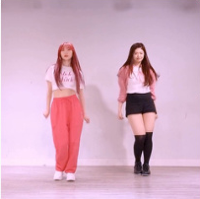
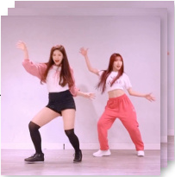


ReferenceNet
Pose
Spatial-Attn
Enc
Cross-Attn
···
···
···
Temporal-Attn
Ref Pose
VAE
Intermediate Feature
Enc
Gradient from 𝒞⁽ˡ⁾
IMG Construction
CLIP
(Training only)
Ref Img
Selected for MSM
DenoisingNet
Pose
VAE
Enc
···
···
···
Dec
Tgt Pose
Gen Frames
Noise
Mask
➜
➜
C⁽¹⁾
xT
C⁽ᴺ⁾
xT

Slide 2
