Slide 1
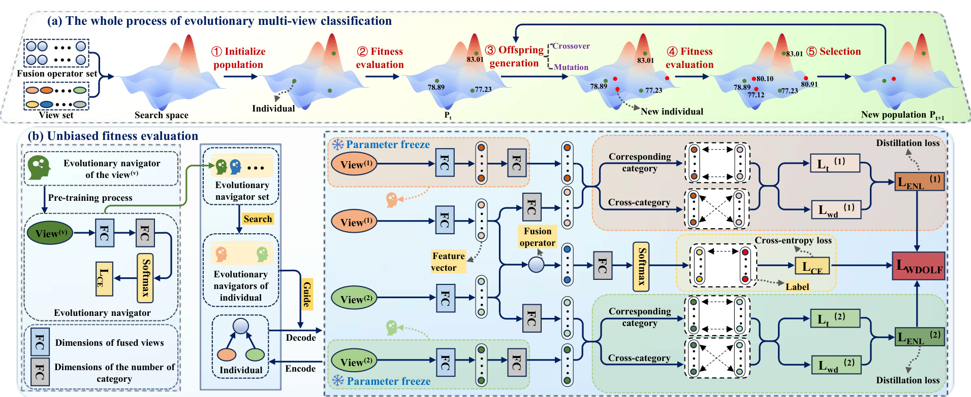
(a) The whole process of evolutionary multi-view classification
① Initialize
population
② Fitness
evaluation
'Crossover
③ Offspring
generation
④ Fitness
evaluation
⑤ Selection
Fusion operator set
Mutation
View set
Search space
Individual
Pₜ
New individual
New population Pₜ₊₁
(b) Unbiased fitness evaluation
⚙ Parameter freeze
Distillation loss
View⁽¹⁾
Corresponding
category
Evolutionary navigator
of the view⁽ᵛ⁾
Evolutionary
navigator set
Pre-training process
View⁽¹⁾
Cross-category
Cross-entropy loss
Search
Feature
vector
Fusion
operator
Evolutionary
navigators of
individual
Label
Guide
View⁽²⁾
Evolutionary navigator
Corresponding
category
Decode
Encode
View⁽²⁾
Cross-category
Individual
Dimensions of fused views
⚙ Parameter freeze
Distillation loss
Dimensions of the number of
category

