Slide 1
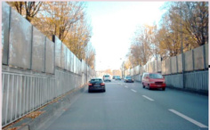
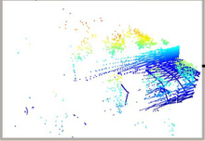
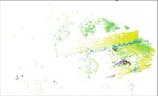
(a) Construction of Object Agent Queries
(b) Dual-queries Consistency Scheme
…
Object Agent Queries
t
✳
Diffusion Model
SVD
Pre-trained Encoder
Add Noise
t′
Latent z₀
r
r
r
Source Image
✳
✳
…
Aggregating Instance Semantic
Quantized Object Agent Queries
…
Learnable Queries
…
…
…
2D Object Agent Queries
2D Auxiliary Object Agent Queries
Dual-queries Design
q_ins
q′_ins
…
MLP
L_consist
…
3D Object Agent Queries
Principal Component Extraction
q_ins_pc
q′_ins_pc
…
Cross-modal Semantic Alignment
Linear
Linear
…
…
Paired
Aggregating Instance Semantic
MLP
q̂₃ᴰ
…
×
S
×
q₃ᴰ
Feature Refinement
Feature Refinement
Layer 1
…
Layer L
Share Weight
Share Weight
Conv
L_seg
L1_sup
Ls_sup
Decoder
Feature Refinement
Feature Refinement
Source Point Cloud
Backbone
(c) Cross-modal Semantic Enhancement
Label

Slide 2
