Slide 1
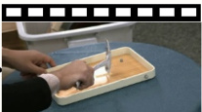
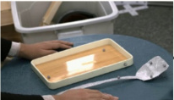
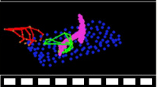
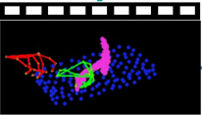
Sample t ∈ 𝒰(1,T)
Sinusoidal PE
Timestep t
× N
eₜ
<spatula, scrape, plate>
T5 Encoder
eₜₑₓₜ
Triple Modality Adaptive Modulation
Prompts P
αₘ¹ | βₘ¹ | γₘ¹
αₘ² | βₘ² | γₘ²
Video V̂
zᵛₜ
S&S
Gate
S&S
Gate
3D VAE Dec
3D VAE Enc
fₜₑₓₜ
Point-wise Feedforward
ẑᵛ₀
zᴵ
⊕
3D Full Attention
eᵥ
Ref Img I
S&S
Gate
S&S
Gate
Rendered Motion Video M̂
fᵥ
3D VAE Dec
3D VAE Enc
ẑᴹ₀
ẑᴹ₀
⊕
eᴹ
S&S
Gate
S&S
Gate
fᴹ
Interaction
Gradient
Guidance
zᴹₜ
Constrain
Synchronized Video-Motion Diffusion (SViMo)
Vision-aware 3D Interaction Diffusion (VID)
⊕
Channel-wise Concat
ℒVID = 𝔼 [∥h₀ − ĥ₀,φ∥₂² + Dchamfer(o₀, ô₀,φ)]
Grad. Backpropagate
Fusion
Diffused Latent Code
Projection
Multiscale 3D Conv
Cross Attention
Generated
S&S
Scale & Shift
Rendered
3D Interaction
(hₜ, oₜ)
Motion Video M̂
(ĥ₀, ô₀)
ℒ
Training Loss Function
Denoising UNet

Slide 2
