Slide 1
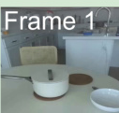
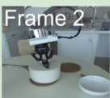
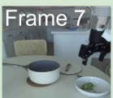
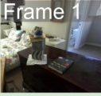
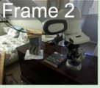
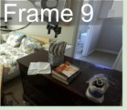
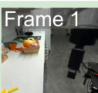
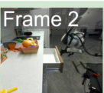
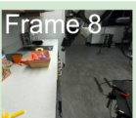
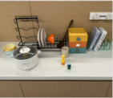
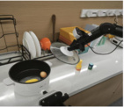
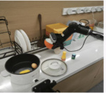
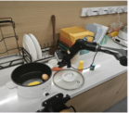
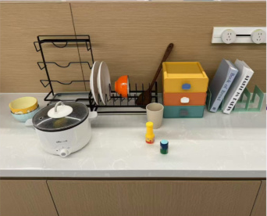
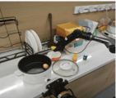
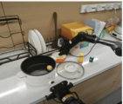
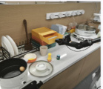
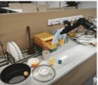
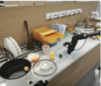
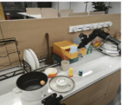
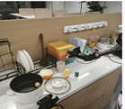
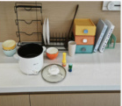
(a) Keyframe Extraction
(b) Atomic Domain Generation
(c) Domain Fusion
Domain Construction & Revision
:predicates (...) :actions ... :precondition (...) :effect (...)
Unified Domain
Atomic Domain
Atomic Domain
⋯
Atomic Domain
Atomic Domain
Learning
DROID Dataset
Solvability Check
Meta Domain
Meta Domain
Feedback
Closed-Loop Refinement
⋯
⋮
Solution Verification
:predicates (...) :actions ... :precondition (...) :effect (...)
Meta Domain
Feedback
Move the corn from the pot into the orange bowl, wipe the table with the towel in the drawer and put it back to the closed drawer.
(d) Problem Generation
(e) Planning
(f) Execution
Meta Domain
Predicate Grouping
PDDL Solver
Planning
Predicate & Operator Filtering
remove_lid (lid)
pick_from_rack (bowl)
place_on_table (bowl)
…
wipe_table (towel)
place_in_drawer (towel)
close_drawer (drawer)
Problem Generation
:objects (...) :init ... :goal (...)

Slide 2
