Slide 1

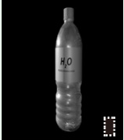
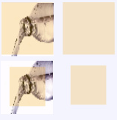

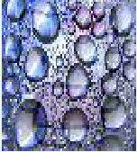



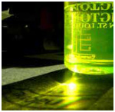


Sample Selection
Explore the effect of triggers on sample selection
via the enhancement of attack success rate and stealthiness.
Component A
attack success rate enhancement
Component B
highlight
large trigger scale
Category Diversity (ours)
Trigger
can be
}
concealed in the black background.
Cancel trigger
Find the appropriate combination
features
on
based on the scale of trigger features .
our method
images by
Trigger
can be
similarity
small trigger scale
Forgetting Events (traditional)
concealed in the complexly texture background.
calculation.
highlight
attack success rate enhancement
the scale of triggers
trigger features
stealthiness ensurement
Triggers
Explore the effect of sample selection on triggers.
Component C
Stealthiness ensurement via avoid selecting single-color dominated samples.
G
Distinct sensitivity of human visual system on RGB
Enhance the trigger feature
mild distortion
severe distortion
subtle distortion
Special samples
R
Green dominated
Blue dominated
on the Blue color channel.
low sensitivity
distinct-color
B
poisoning
R
G
B

Slide 2
