Slide 1
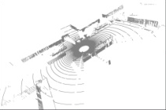
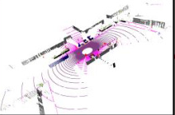
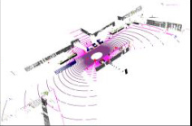
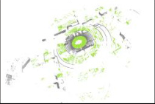
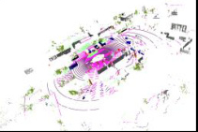
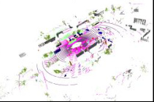

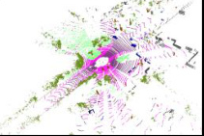
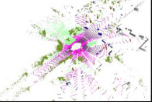
Sourse Domain
Additional Structural Priors
ℒ^{s}
1
2
3
1
2
3
ℰ_{stu}
𝒟_{stu}
ℒ_{permutation}
4
5
6
4
5
6
7
8
9
Permutation Invariance Prior
7
8
9
x^{s}
f_{stu}(x^{s})
y^{s}
Shared
Shared
Hilbert curves
Z-order curves
Mixed Domain
1
2
4
3
5
7
6
8
9
1
4
7
2
5
8
3
6
9
z
y
1
2
3
ℒ_{local}
1
2
3
ℒ_{mix}
4
5
6
ℰ_{stu}
𝒟_{stu}
4
5
6
x
Local Consistency Prior
7
9
7
8
9
8
f_{stu}(x^{mix})
y
x^{mix}
Feature F
y^{mix}
Rectangular Partition
z
Cylindrical Partition
EMA update
EMA update
x
1
2
3
4
5
6
7
8
9
5
4
2
6
8
1
3
9
7
Target Domain
1
2
3
1
2
ℒ_{geometric}
ℒ^{t}
4
5
6
5
6
ℰ_{tea}
𝒟_{tea}
Geometric Consistency Prior
τ
7
8
9
7
9
High Density
Low Density
Input
x^{t}
Prediction
f_{tea}(x^{t})
(Pseudo) Label
ŷ^{t}
1
2
3
4
5
6
7
8
9
1
2
5
6
7
9

Slide 2
