Slide 1


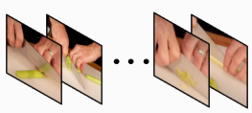
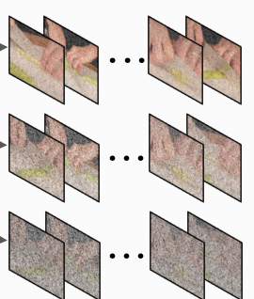
Measure Difficulty based on Relative Reward Statistics
Dynamic Global Reward
Â⁽ⁱ⁾ = ℛ(x, y⁽ⁱ⁾) − μᵣ
ℛgroup
σᵣ
Reward
Response
y¹
ℛ(x, y¹)
ℛgroup = {0.0, 0.0, ..., 0.0, 0.0}
Video
Response
y²
ℛ(x, y²)
Question:
What action
LLM
⋯
⋯
ℛgroup = {1.1, 0.3, ..., 1.9, 0.8}
Replay
should I take next in
𝔹ᵂ
Buffer
order to eat the celery?
Response
yᴳ
ℛ(x, yᴳ)
ℛgroup = {2.0, 2.0, ..., 2.0, 2.0}
Iteration
Difficulty Decreasement Augmentation
ℛgroup
Difficulty Increasement Augmentation
Response
y¹gt
ℛ(x, y¹gt)
Perturbation Level
Video
Response
y²gt
ℛ(x, y²gt)
Question:
What action
LLM
⋯
should I take next in
⋯
order to eat the celery?
Δℛ < 0
Response
yᴳgt
ℛ(x, yᴳgt)
GT:
B. pick up celery
Δℛ ≈ 0
y²gt
<think> The video shows a person preparing ... .
To make a slice of celery, you
Δℛ > 0
should bring it from the bag.
</think><answer>B. pick up celery</answer>
Guidance Level

Slide 2
