Slide 1
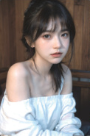
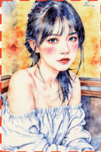







In-context Editing Framework based on T2I DiT
Edit by
In-context
Generation
LoRA-MoE Module
T2I Diffusion Transformer
+
Inversion × N
Inverted Noise
Base Layer
Decoder
Source Image
Feature
Injection
Denoising × N
N×
+
…
+
×
Expert 1
Expert 2
Expert 3
Expert N
concat
T2I Diffusion Transformer
Inverted
Noise
Random
Noise
Out Projection
crop
TopK=1
✓
×
×
“ A diptych with two side-by-side images of the same scene.
MLP
MM Attention
On the right, the scene is the same as on the left, but
Route
make the man grab a basketball.”
Generated
Target Image
Norm & Mod
In-context Editing Framework based on Inpainting DiT
+
concat
: Trainabe Parameter
Text Encoder
Image Encoder
: Frozen Parameter
mask
Inpainting DiT
crop
concat
Image
Mask
Noise
: Standard LoRA Tuning
Noise
“ A diptych with ...
: LoRA-MoE Tuning
Image with Mask
but ‘what if it
looks like water
color painting?’ ”
Source Image
“A diptych with ... but
Target
Image
: LoRA Adapter
make her hold a red can.”
(a) Training-free Structure of ICEdit
(b) Finetuning Strategy for ICEdit

Slide 2
