Slide 1
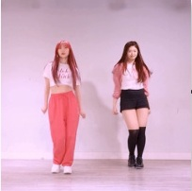
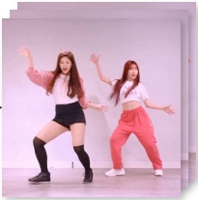
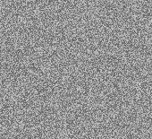
ReferenceNet
Pose
Spatial-Attn
Enc
Cross-Attn
···
···
···
Temporal-Attn
Ref Pose
VAE
Intermediate Feature
Enc
Gradient from C⁽ˡ⁾
IMG Construction
(Training only)
CLIP
Ref Img
Selected for MSM
DenoisingNet
Pose
···
···
···
VAE
Enc
Dec
Tgt Pose
Gen Frames
Noise
Mask
C⁽¹⁾
C⁽ᴺ⁾
xT
xT

Slide 2
