Slide 1
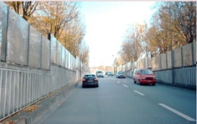
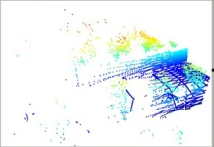
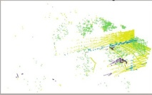
(a) Construction of Object Agent Queries
(b) Dual-queries Consistency Scheme
Pre-trained Encoder
Add Noise
···
Object Agent Queries
t
Diffusion
Model
SVD
k
k
k
k
{
{
{
{
{
Latent z₀
t′
r
r
r
{
Source Image
⌣
⌣
⌣
Aggregating Instance Semantic
c
c
c
···
Quantized Object Agent Queries
Learnable Queries
···
···
···
2D Object Agent Queries
2D Auxiliary Object Agent Queries
Dual-queries
Design
qᵢₙₛ
q′ᵢₙₛ
MLP
ℒ₍consist₎
3D Object Agent Queries
Principal Component Extraction
qᵢₙₛ_ₚ꜀
q′ᵢₙₛ_ₚ꜀
Paired
···
Cross-modal Semantic Alignment
Linear
Linear
q̂₃ᴅ
q₃ᴅ
···
S
MLP
···
Aggregating Instance Semantic
Feature
Refinement
···
Feature
Refinement
Conv
ℒ₍seg₎
Layer 1
Layer l
Decoder
···
Share
Weight
ℒ¹₍sup₎
Share
Weight
ℒˢ₍sup₎
Label
Feature
Refinement
Source Point Cloud
Backbone
Feature
Refinement
(c) Cross-modal Semantic Enhancement

Slide 2
