Slide 1
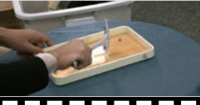
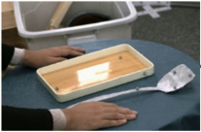
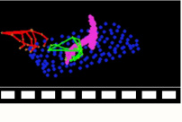
Sample t ∈ U(1,T)
Sinusoidal PE
Timestep t
e_t
× N
L_SViMo = E[ ||z0V−ẑ0θV||² + ||z0M−ẑ0θM||² ]
<spatula, scrape, plate>
❄
e_text
T5 Encoder
Triple Modality Adaptive Modulation
Prompts P
αₘ¹, βₘ¹
γₘ¹
αₘ², βₘ²
γₘ²
zₜᴵ
❄
❄
S&S
Gate
S&S
Gate
ẑ₀ⱽ
3D VAE Dec
Video V̂
zᴵ
e_V
f_text
3D VAE Enc
S&S
Gate
S&S
Gate
❄
Ref Img I
3D Full Attention
Point-wise Feedforward
❄
f_V
ẑ₀ᴹ
3D VAE Dec
Rendered Motion Video M̂
3D VAE Enc
z̃₀ᴹ
e_M
S&S
Gate
S&S
Gate
f_M
Interaction Guidance
zₜᴹ
Gradient Constrain
Synchronized Video–Motion Diffusion (SViMo)
Vision-aware 3D Interaction Diffusion (VID)
Channel-wise Concat
L_VID = E[ ||h0−ĥ0ϕ||² + D_chamfer(o0, ô0ϕ) ]
Grad. Backpropagate
Diffused Latent Code
Fusion
Projection
Multiscale 3D Conv
Cross Attention
Generated 3D Interaction (ĥ₀, ô₀)
Scale & Shift
Rendered Motion Video M̃
S&S
ℒ
Training Loss Function
Denoising UNet
(hₜ, oₜ)

Slide 2
