Slide 1
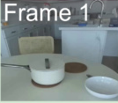
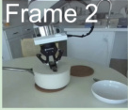
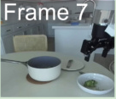

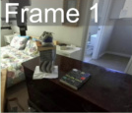
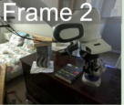
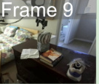
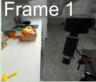
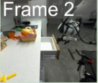
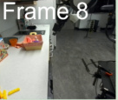
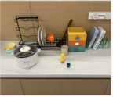
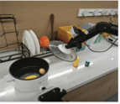
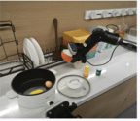
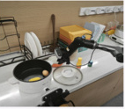
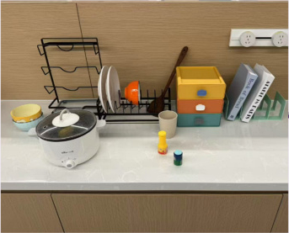
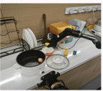
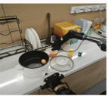
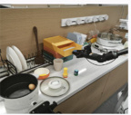
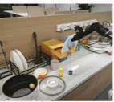
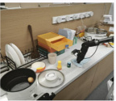
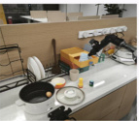
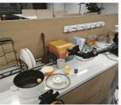
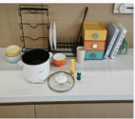
(a) Keyframe Extraction
(b) Atomic Domain Generation
(c) Domain Fusion
Frame 1
Frame 2
...
Frame 7
Unified Domain
Domain Construction
& Revision
:predicates (...)
:actions ...
:precondition (...)
:effect (...)
Atomic
Domain
Atomic
Domain
...
Atomic
Domain
Atomic
Domain
DROID
Dataset
Frame 1
Frame 2
...
Frame 9
Learning
Solvability
Check
Meta
Domain
Meta
Domain
Feedback
Closed-Loop
Refinement
...
Frame 1
Frame 2
...
Frame 8
Solution
Verification
Feedback
:predicates (...)
:actions ...
:precondition (...)
:effect (...)
Meta
Domain
Move the corn from the pot
into the orange bowl, wipe the
table with the towel in the
drawer and put it back to the
closed drawer.
(d) Problem Generation
(e) Planning
(f) Execution
Meta
Domain
Predicate
Grouping
PDDL
Solver
Planning
Predicate
& Operator Filtering
remove_lid (lid)
pick_from_rack (bowl)
place_on_table (bowl)
...
wipe_table (towel)
place_in_drawer (towel)
close_drawer (drawer)
Problem
Generation
:objects (...)
:init ...
:goal (...)

Slide 2
