Slide 1
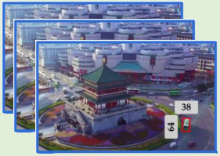
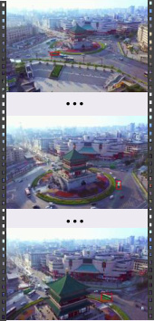
···
···
···
···
···
high-level
mid-level
low-level
Predicted Tube
S₅
Multi-level
Language
Modulation
···
···
···
Visual
Encoder
Cross-scale Visual-only
Fusion Branch
···
···
···
S₄
S₃
···
···
···
···
···
···
···
⋮
High-level
Decoder
Mid-level
Decoder
Low-level
Decoder
The green bus that is
heading to the upper
right, from the lower left
corner of the Bell Tower
roundabout
···
···
Language
Encoder
Intra-scale
Multi-modality
Interaction Branch
Query and
Position
Generator
Linear
Object
query
Multi-level Progressive
Spatial Decoder
···
···
···
···
···
···
···
(a)
(b)
(c)
···
···
···
···
···
···
···
···
···
···
···
···
Fusion
Fᶠᵥ₅
Conv1×1 s1
×N
BN
temporal interaction layer
Fᶰᵥ₅
SiLU
FD
learnable
video token
Cross-scale Visual-only
Fusion Branch
···
···
Intra-scale Multi-modality
Interaction Branch
Fusion
Fᶠᵥ₄
C
⋯
Fᵥ₄
1×1
Conv
1×1
Conv
spatial interaction layer
frame T
spatial interaction layer
FD
SAC
spatial interaction layer
frame 2
···
···
RepBlock ×3
frame 1
Fᶠᵥ₃
···
···
···
···
···
···
Fᵥ₃
visual
token
language
token
learnable
frame token
MSFF-FE
F
(b.1)
(b.2)
Fusion

Slide 2
