Slide 1

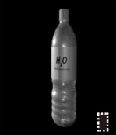










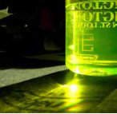

Sample Selection
Explore the effect of triggers on sample selection
via the enhancement of attack success rate and stealthiness.
Component A
attack success rate
Component B
stealthiness
highlight
enhancement
enhancement
large trigger scale
Trigger
can be
Category Diversity (ours)
concealed in the
black
Cancel trigger
background.
features
on
Find the appropriate combination
based on the scale of trigger features
.
our method
images by
similarity
Trigger
can be
calculation.
small trigger scale
Forgetting Events (traditional)
concealed in the
complexly texture
highlight
background.
attack success rate
the scale of triggers
trigger features
stealthiness
enhancement
ensurement
Triggers
Explore the effect of sample selection on triggers.
Component C
Stealthiness ensurement via avoid selecting single-color dominated samples.
G
Distinct sensitivity of human visual system on RGB
mild distortion
severe distortion
subtle distortion
Special samples
R
Enhance the trigger feature
Green
Blue
on the Blue color channel.
dominated
dominated
low sensitivity
distinct-color
B
R
G
B
poisoning

Slide 2
