Slide 1
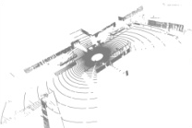
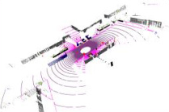
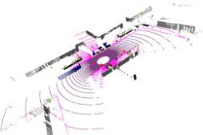
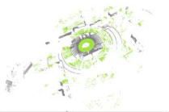
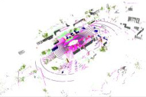


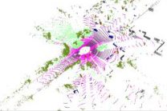

Sourse Domain
Additional Structural Priors
ℒ
ℰ
𝒟
s
1
2
3
1
2
3
stu
stu
ℒ
permutation
4
5
6
4
5
6
Permutation
7
8
9
s
f
s
s
7
8
9
Invariance Prior
x
stu
(x
)
y
Shared
Shared
Hilbert curves
Z-order curves
Mixed Domain
1
2
4
3
5
7
6
8
9
1
4
7
2
5
8
3
6
9
z
y
1
2
3
ℒ
1
2
3
ℒ
mix
local
ℰ
𝒟
4
5
6
4
5
6
stu
stu
x
7
9
Local
8
7
8
9
Consistency Prior
mix
mix
mix
y
x
Feature
F
f
(x
)
y
z
x
stu
Rectangular Partition
Cylindrical Partition
EMA
EMA
1
2
3
4
5
6
7
8
9
5
4
2
6
8
1
3
9
7
update
update
Target Domain
1
2
3
1
2
ℒ
geometric
ℒ
4
5
6
5
6
ℰ
𝒟
t
tea
tea
7
8
9
Geometric
7
9
τ
Consistency Prior
t
t
High Density
Low Density
x
f
t
ŷ
Input
Prediction
tea
(x
)
(Pseudo) Label
1
2
3
4
5
6
7
8
9
1
2
5
6
7
9
Notes:
Reconstructed from the supplied BeyondMix reference. Text, mathematical labels, cells, planes, circles, borders and arrows are editable PowerPoint objects. The nine point-cloud viewports are embedded raster crops. Original wording, including “Sourse Domain”, is preserved.

Slide 2
