Slide 1
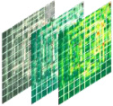








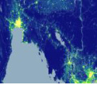
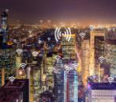
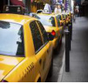
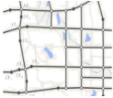
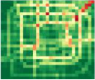
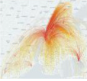





Output
Frequency pattern
Reshape
Temporal pattern
ST
Data
Spatial pattern
Data
Data-driven prompt
Urban Diffusion Transformer
memory
Different
Sequential
data types
format
Concat
Attention
Mask
Task
Spatio-temporal
Embedding
memory
Task-specific prompt
patching
layer
(d) Unified Prompt Learning
Noisy
Timestep
Multiple Domains
ST data
t
Multiple Cities
(a) Datasets
(b) Urban Diffusion Transformer
(c) Masking Strategies
Notes:
Editable reconstruction of the user-supplied reference. Text, connectors, frames, brains, graph patches, and token cubes are native PowerPoint elements. The six domain thumbnails, seven noise tokens, and seven heatmap stacks are separately embedded raster assets, preserving the original data appearance.

Slide 2
