Slide 1
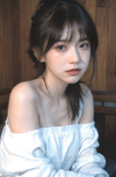
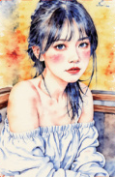










In-context Editing Framework based on T2I DiT
Edit by
LoRA-MoE Module
In-context
T2I Diffusion Transformer
Generation
Inversion × N
Inverted Noise
Base Layer
Decoder
Source Image
Feature
Injection
N×
Denoising × N
...
+
concat
T2I Diffusion Transformer
Expert 1
Expert 2
Expert 3
Expert N
Inverted
Random
Out Projection
Noise
Noise
crop
TopK=1
“ A diptych with two side-by-side images of the same scene.
MLP
MM Attention
On the right, the scene is the same as on the left but
Route
{make the man grab a basketball}. ”
Generated
Norm & Mod
Target Image
In-context Editing Framework based on Inpainting DiT
+
concat
: Trainable Parameter
Text Encoder
Image Encoder
: Frozen Parameter
mask
Inpainting DiT
concat
crop
Image
Mask
: Standard LoRA Tuning
Noise
Noise
“ A diptych with ...
: LoRA-MoE Tuning
Image with Mask
but {what if it
Source Image
“ A diptych with ... ... but
Target
looks like water
{make her hold a red can}. ”
Image
color painting?}”
: LoRA Adapter
(a)
Training-free Structure of ICEdit
(b)
Finetuning Strategy for ICEdit
Notes:
Reconstructed from the user-provided reference. All labels are editable text, and diagram elements are native PowerPoint vectors. Photographic examples and two noise textures are embedded raster crops. Canvas: 1908 × 1071. SVG and PPTX generated from one common coordinate model.

Slide 2
