Slide 1
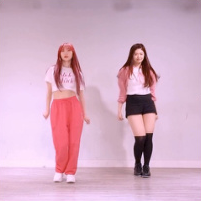
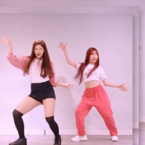
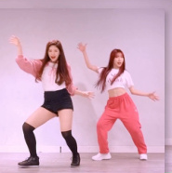
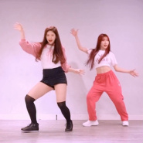
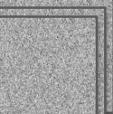
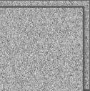
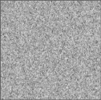
ReferenceNet
Pose
Spatial-Attn
Enc
Cross-Attn
Temporal-Attn
Ref Pose
Intermediate Feature
VAE
Enc
Gradient from
𝓒
(ℓ)
IMG Construction
(Training only)
CLIP
Ref Img
Selected for MSM
DenoisingNet
Pose
VAE
Enc
Dec
Tgt Pose
T
Noise
Gen Frames
Mask
𝓒
(1)
𝓒
(N)
xT
xT

Slide 2
