Slide 1
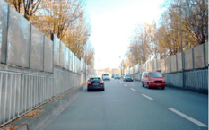
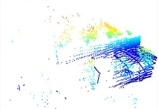
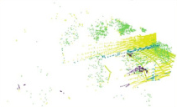
(a) Construction of Object Agent Queries
(b) Dual-queries Consistency Scheme
···
Object Agent Queries
Pre-trained
Encoder
Add Noise
t
Diffusion
Model
k
k
SVD
k
k
Latent
z
t′
r
k
r
k
r
k
k
Source Image
0
Aggregating Instance Semantic
c
c
c
···
···
Quantized Object Agent Queries
Learnable Queries
···
···
2D Object Agent Queries
···
Dual-queries
Design
q
ins
q′
ins
···
MLP
ℒ
···
2D Auxiliary Object Agent Queries
consist
3D Object Agent Queries
Principal Component Extraction
q
q′
ins_pc
ins_pc
Cross-modal Semantic Alignment
···
Linear
Linear
Paired
S
q̂
3D
q
3D
···
MLP
···
Aggregating Instance Semantic
Feature
Refinement
···
Feature
Refinement
Conv
ℒ
seg
Layer 1
···
Layer L
Share
Weight
ℒ
1
Share
Weight
ℒ
S
Decoder
Label
sup
sup
Feature
Refinement
Feature
Refinement
Source Point Cloud
Backbone
(c) Cross-modal Semantic Enhancement
Notes:
Recreated from the supplied reference diagram. All text, blocks, arrows, query matrices and brackets are editable PowerPoint objects. Only the street photograph and two point cloud visualizations are embedded image crops.

Slide 2
