Slide 1




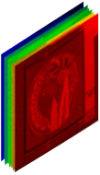

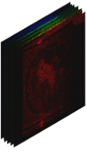
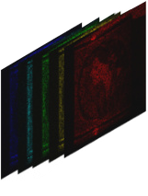
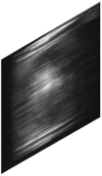




(a)
y
y
y
C
Concatenate
ℰ
(·)
ℰ
(·)
ℰ
(·)
Element-wise
w
(1)
w
(2)
w
(K)
multiplication
Initialization
Σ
(1)
Σ
(2)
Σ
(K)
…
Matrix
proj(·)
prox
R
(·)
proj(·)
prox
R
(·)
proj(·)
prox
R
(·)
multiplication
z
(1)
z
(2)
z
(K)
Σ
Weighted-Sum
y
H
(y, H)
(y, H)
(y, H)
Down-
Down
sample
(c)
(b)
C
X′
M′
X″
Y
Up
Up-
C×H×W
C×H×W
sample
Conv3x3
Conv3x3
Dispersion
Imaging
LN
LayerNorm
C×H×W
C×H×W
C×H×W
Spa-LWSA
C
Fusion
Spec-TKSA
Chromaticity
Mask
Modulated HSI
Dispersed HSI
Measurement
1x1
Convolution
1×1
C×H×W
Down
C×H×W
Up
(d)
2C×
H
×
W
H
W
2C×
H
×
W
Q
C×HW
2
2
2C×
2
×
2
2
2
C×C
Spa-LWSA
C
Fusion
Spec-TKSA
1X1
2C×
H
×
W
K
Mask
Softmax
2
2
2C×
H
W
LN
1X1
Down
2
×
2
Up
C×H×W
C×HW
4C×
H
×
W
4C×
H
×
W
V
4
4
4
4
C×HW
Spa-LWSA
1X1
Σ
1X1
C×H×W

Slide 2
