Slide 1
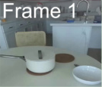
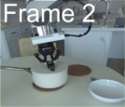
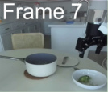
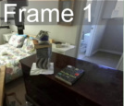
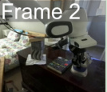
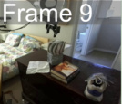
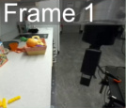
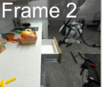
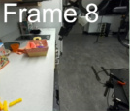
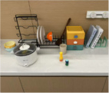
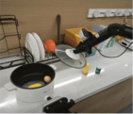
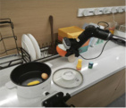
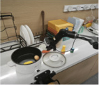
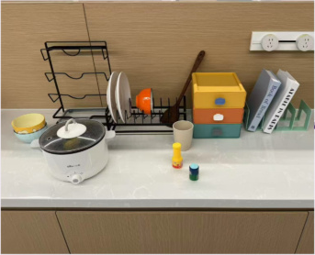
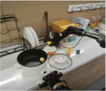
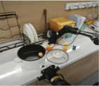
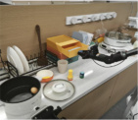
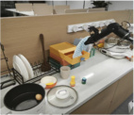
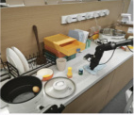
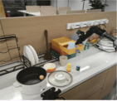
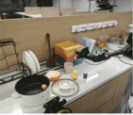
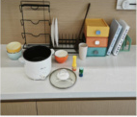
(a) Keyframe Extraction
(b) Atomic Domain Generation
(c) Domain Fusion
Domain Construction
& Revision
:predicates (...)
Unified Domain
...
:actions ...
Atomic
Domain
Atomic
Domain
Atomic
Domain
Atomic
Domain
:precondition (...)
...
:effect (...)
Learning
DROID
Dataset
...
Solvability
Check
Meta
Domain
Meta
Domain
Feedback
Closed-Loop
Refinement
...
Solution
Verification
Feedback
:predicates (...)
...
:actions ...
Meta
Domain
:precondition (...)
:effect (...)
Move the corn from the pot
into the orange bowl, wipe the
table with the towel in the
drawer and put it back to the
closed drawer.
(d) Problem Generation
(e) Planning
(f) Execution
Meta
Domain
Predicate
Grouping
PDDL
Solver
Planning
remove_lid (lid)
Predicate
& Operator Filtering
pick_from_rack (bowl)
place_on_table (bowl)
...
Problem
Generation
wipe_table (towel)
:objects (...)
place_in_drawer (towel)
:init ...
close_drawer (drawer)
:goal (...)

Slide 2
