Slide 1
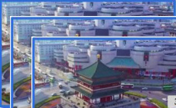

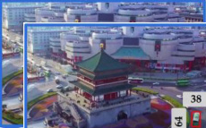
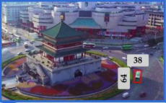
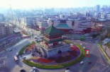

···
···
···
high-level
mid-level
low-level
Predicted Tube
S
···
···
···
5
Multi-level
Language
Modulation
···
···
···
Visual
Encoder
S
Cross-scale Visual-only
Fusion Branch
4
S
3
···
···
···
High-level
Decoder
Mid-level
Decoder
Low-level
Decoder
···
···
···
The green bus that is
heading to the upper
right, from the lower left
corner of the Bell Tower
roundabout
···
Language
Encoder
Intra-scale
Multi-modality
Interaction Branch
Query and
Position
Generator
···
Linear
···
Object
query
Multi-level Progressive
Spatial Decoder
···
···
···
(a)
(b)
(c)
···
···
···
Fusion
F
F
Conv1×1 s1
v5
···
BN
temporal interaction layer
×N
F
N
v5
FD
SiLU
learnable
video token
···
F
F
F
v4
C
Intra-scale Multi-modality
Interaction Branch
···
Cross-scale Visual-only
Fusion Branch
v4
Fusion
spatial interaction layer
1×1
Conv
1×1
Conv
spatial interaction layer
···
frame
T
spatial interaction layer
FD
SAC
F
F
frame 2
v3
RepBlock
×3
frame 1
···
···
···
learnable
frame token
F
v3
MSFF-FE
F
visual
token
language
token
(b.1)
(b.2)
Fusion
Notes:
Reconstructed from the user-provided reference. All labels, modules, tokens and connectors are editable native PowerPoint elements. The six aerial video crops are separately embedded photographs. The SVG is also composed of editable vector shapes and live text.

Slide 2
