Slide 1
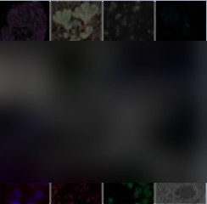
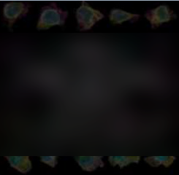
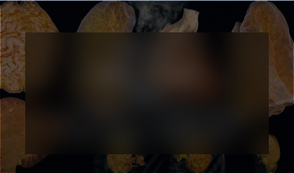
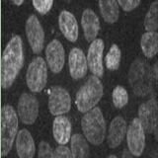

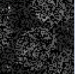
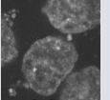
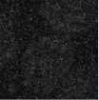
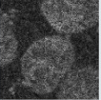

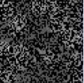
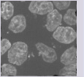
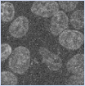
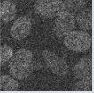

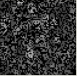
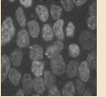
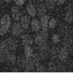
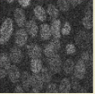
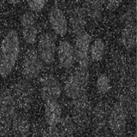
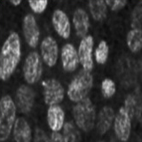
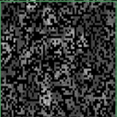
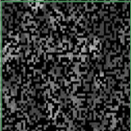
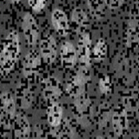
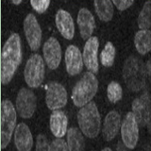
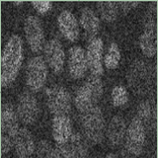
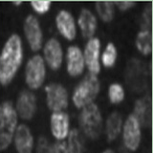
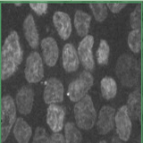
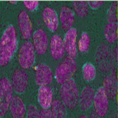
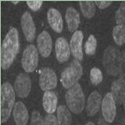
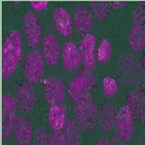
1 Raw Data Sampled
12 Combo
Masked
Deformed
Noisy
Low-Res
2/3D selection
window
IDR
Public Repository of
Image Datasets
hiPSC
Single-cell Image
Dataset
HiP-CT
Human Organ
Atlas
Raw
Local
>100 studies
>14,000,000 images
>200,000 cells
25 cellular structures
>150 patients, >10,000 samples
5 organ types, 6 Imaging Scale
••• •••
1/2
Mid-range
Raw-level Dataset, 2-5D dimensionality, MB-TB level file size
Multi-modal, Multi-dimensionality Dataset with Random Multi-scale Sampling (RMS)
1/4
Global
Task: Image Restoration
Task: Image Fusion
Mamba
Encoder
Mamba
Encoder
Random
Noise
Random
Masking
Raw
Noisy
Conv
Decoder
Restored
Raw
Masked A
Masked B
Visible A&B
Conv
Decoder
Fuse+ReConed
Task: Image Super-resolution
Task: Image Registration
Mamba
Encoder
Mamba
Encoder
Random
Low-Res
Random
Deforming
Raw
Downsampled
Conv
Decoder
Upsampled
Raw
Deformed
Error Map
Conv
Decoder
Registrated
Error Map
Misalign
Align
Task-related Joint-embedding Pre-training (TJP) on Multi-head Hierarchy Mamba2 (MHM)

Slide 2
