Slide 1
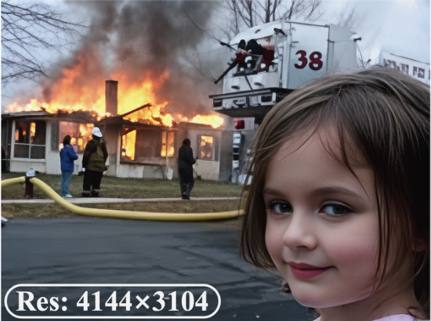
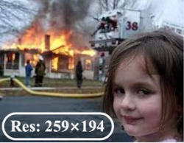
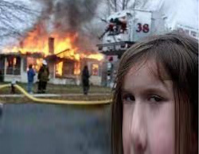

P
Profile Module
P
Perception Agent
R
Restoration Agent
4K
Task 1
Face
Stage 1: Image Analyzer
Execution
Rollback
VLM
if low
quality
R
Preference
Profile
Quality
scores
Reflection
Re-Plan
Stage 2: Degradation Reasoning
& Task Planning
if SR
Face Restoration
Description
Task 2
Restoration Plan
⋮
Res: 259×194
Task K
Res: 4144×3104
Stage 1
Task 1
Task 2
Task 3
CLIPIQA+: 0.6344
TOPIQ: 0.5907
MUSIQ: 62.9828
NIQE: 3.5966
Super-Resolution
Denoising
Super-Resolution
Task 1 Super-Resolution
Expert IQA
Quality Scores
Face Crop
Execution
Q-MoE
Face Restoration
Stage 2
Description
Experience
Tool 1
Tool 2
Tool N
Tool 1
Tool 2
Tool N
"A young girl with
long brown hair, …
firefighting efforts."
Agenda
…
…
["DN", "SR", "SR"]
VLM
▲
VLM
▼
Description
Score-based Select for face
Distortion
["Noise", "LR", "LR"]
Distortions
Reflection
Face Q-MoE
Quality Scores
"Noise"
+ "LR"×2
Score-base Select
Upscaling Setting for 4K
Paste
Best Face from
Tool 1
High quality ?
No
☺
Output
Restoration Plan
Rollback
(0.927,
Super-Resolution
Denoising
Super-Resolution
Tool 4

Slide 2
