Slide 1
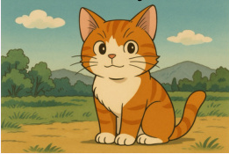
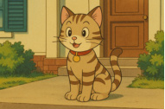
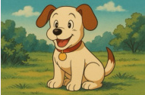

(A) Overall Pipeline
(C) Overall Training Process
Query
Candidate 1
Candidate 2
Candidate K
Stage 1: Self-Alignment for Pretraining ICM
T
Relationship
Prompt Template:
q
According to <rel>, describe the
similarity, difference and any
potential relationship between the
pair in detail.
CE
Loss
T
LLM
c
Find an image with
a different animal
but the same style.
T
T
T
CE
Loss
c₁
c₂
cK
ICM
Content Prompt Template:
Information Compression Module (ICM)
Describe the content of <c> in detail.
t
con
t
rel
t
c1
t
c1
t
c2
t
c2
t
cK
t
cK
T
con
rel
con
rel
con
rel
Stage 2: SFT with Synthetic Dataset for Activation
q
Large Language Model
• (1): Retrieval result speculation
• (2): Quick verification for negative samples
(3): Refined verification for positive samples
(4): Retrieval result generation
SFT
LLM
<think> ... <inspection-index-start>2<inspection-index-end>T_c₂ ... <inspection-
index-start>K<inspection-index-end>T_cK ... </think> <answer>2</answer>
Annotation
MLLM
Synthetic
CoT Dataset
Stage 3: RL with Curriculum Reward for Enhancement
(B) Information Compression Module (ICM)
T
T
T
o₁
Reward Calculation
r₁
e
Format
Result
Efficiency
con
c
c
q
LLM
o₂
r₂
GRPO
ATT 1
ATT 2
ATT 1
oG
✓
rG
R
e
con
Rollout
Reward
t
con
q,c
t
rel
Optimize

Slide 2
