Slide 1
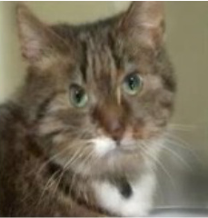
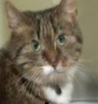
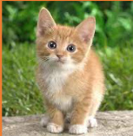
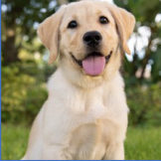
Rematching
Inference
g_{ω}
Initial Matching
t̂_{s}
Param.
Pool P
⋯
Classifier g_{θg}
Testing sample
Pretrained h_{ptm}
Rematching
Class ŷ
Direct
MLP
Task
Task ID t̂_{s}
⋮
ID t̂_{f}
Selected p
Yes
No
t̂_{f} ≠ t̂_{s}
Pretrained h_{ptm}
p_{t̂s}
p_{t̂f}
Classifier g_{θg}
Confidence-based
T₁
T₂
T₃
⋯ T_{t−1}
Direct
Task-t training data
Training
d
⋯
⋯
Distribution d̃
top-K
W₁
W₂
Wₖ
Old feature space
Confidence E
⋮
{T₁, T₃, T₄ ⋯ T_{j}}
L_{CTIRD}
E < τ
CIRP
Yes
Param.
Pool P
⋯
t̂_{s} = argmax E(x; p_{i})
Wₜ
i ∈ Γ
New feature space

Slide 2
