Slide 1
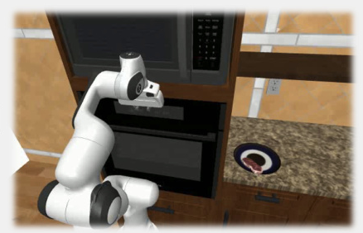
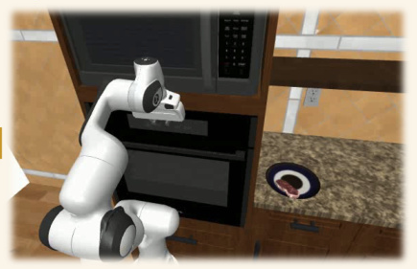
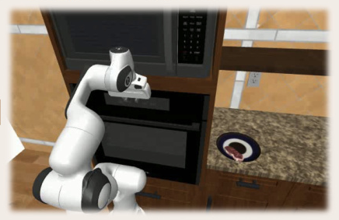
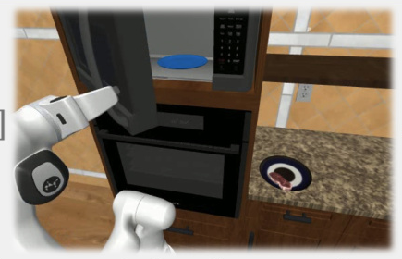
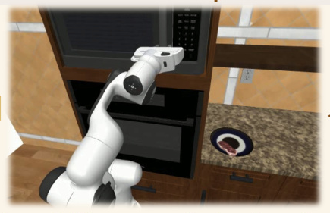
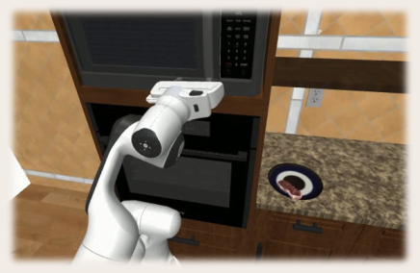
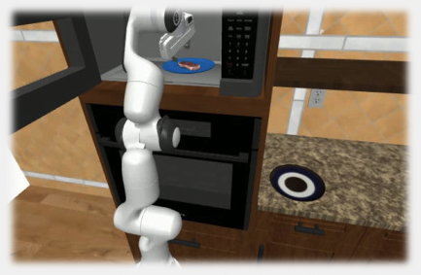
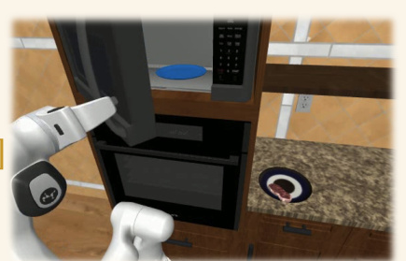
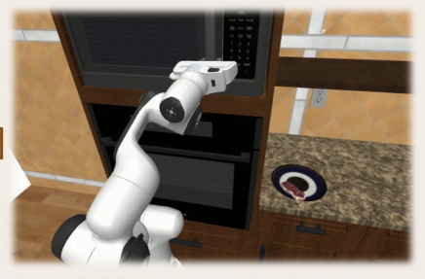
Task: “Thaw the steak in the microwave”
Task: “Open microwave door”
Task: “Grasp door handle”
[o
]
φ
[o
]
φ
[o
]
0
0
0
The gripper is in front of microwave...
The gripper is in front of microwave...
The gripper is in front of microwave...
The robot needs to: “Open microwave door”
The robot needs to: “Grasp door handle”
Task progress: 0%
[o
]
[o
]
[o
14
]
9
1
The robot opened the microwave door.
The robot fully grasped the door handle.
The gripper moved closer to the door...
The robot needs to: “Put steak in microwave”
The robot needs to: “Pull door open”
Task progress: 40%
ψ
ψ
[o
31
]
[o
14
]
[o
]
9
The robot put the steak in the microwave.
The robot opened the microwave door.
The robot needs to: “Close microwave door”
Task is complete.
The robot fully grasped the door...
Task progress: 100%
Task is complete.

Slide 2
