Slide 1
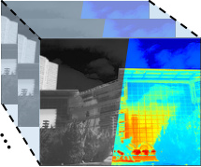
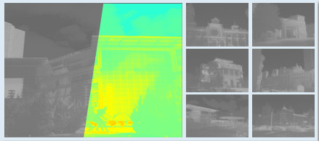
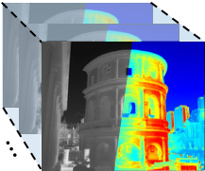
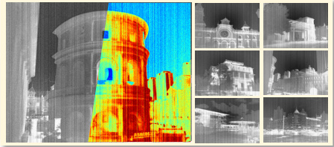


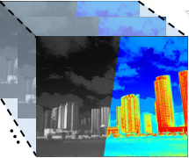
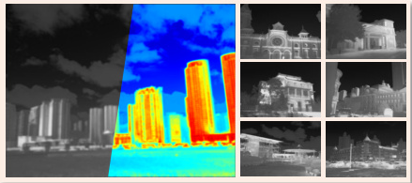
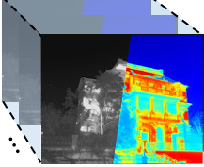
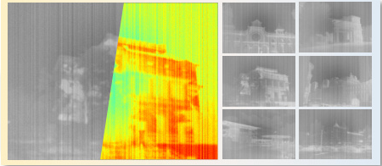


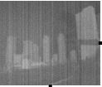
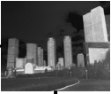
(a) Infrared Degradation Processing
Low Contrast
Noise
Contrast Degradation
Gaussian
Standard
Random
Blur
Mixture
Gaussian Blur
Sequential Blending
(b) Dual Prompt Processing
(c) IR Multi-Degradation Restoration Network
(d) SPT
Degradation Descriptor
TP
S
0
0
0
0
0
1
Iter.1
Nθ
N
Type/Degradation-specific
Prompts
Nθ
B
H
0
0
0
0
1
0
Update
Degraded
Inf. Image
Restored
Inf. Image
Iterative
Nθ
C
1×1×64
Prompt Fusion
γ
β
Iter.2
Iter.3
N
0
0
0
0
0
1
Nθ
N
B
0
0
0
0
1
0
IR Block
Iter.n
Nθ
B
Update
C
Nθ
C
Selective Progressive Training(SPT)
DSP
S
H
N
B
C
Single Degraded
Hybrid Degraded
Noise
Blur
Contrast
DSP:
Degradation-specific Prompts
TP:
Type Prompt
FP
BP
Parameter update

Slide 2
