Slide 1

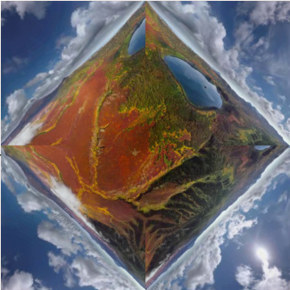



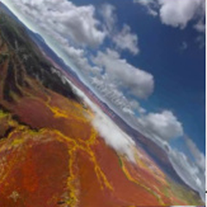




CubeMap
project
r → r*
F
project
U
L
L
U
F
F
B
L
F
R
L
B
D
F
√2 a
a
U
R
B
U
Equirectangular Map
remap
ViewPoint Map
add noise
Pano Attention
Perspective Attention
Input
L
Attn
Block
F
Attn
Block
concat
L
F
B
R
Projected Input Perspective Video
B
R
× N
Output
Mask
Prompt

Slide 2
