Slide 1
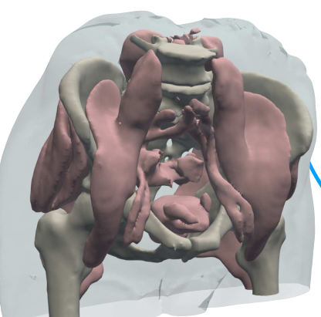
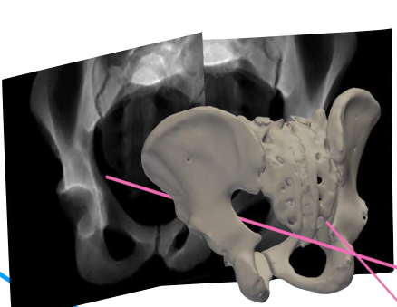
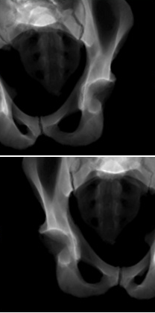
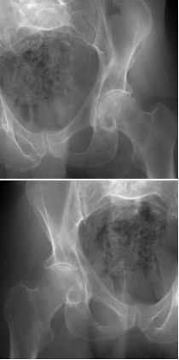
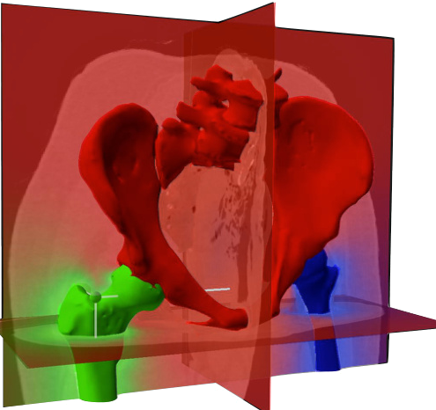
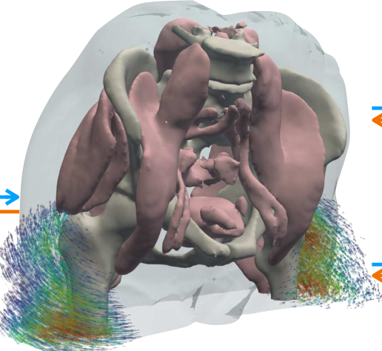
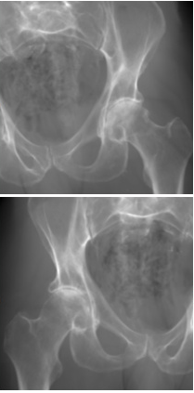

(A) Stage 1: Estimate the pose (Π̂) of each X-ray image
Operation flow
Gradient flow
Rendered X-ray
Real X-ray
𝒫(Π1)
ℒ
Diff. X-ray
renderer
Eq. (3)
𝒫(Π2)
ℒ
Diff. X-ray
Extract structure
renderer
Eq. (3)
S
anchor
⊙ V
Π1
Π2
Preoperative CT (V)
(B) Stage 2: Optimize structure-specific poses
(
)
to estimate the polyrigid deformation field (Φ)
𝒫
Projection operator
ξ̂
Articulated poses
ℒ
Image loss function
Π
Camera matrix
ξ̂
Rendered X-ray
Real X-ray
log(𝒯)
𝒫(Π1)
log(𝒯)
ℒ
Diff. X-ray
log(𝒯)
renderer
Eq. (3)
Eq. (7)
exp(W ξ̂)
𝒫(Π2)
ℒ
0.24
Diff. X-ray
renderer
0.75
Eq. (3)
Eq. (7)
Precompute weight field W
0.01
Sample deformation field Φ and warp V
Eq. (6)
W(x)
Eq. (4)

Slide 2
