Slide 1
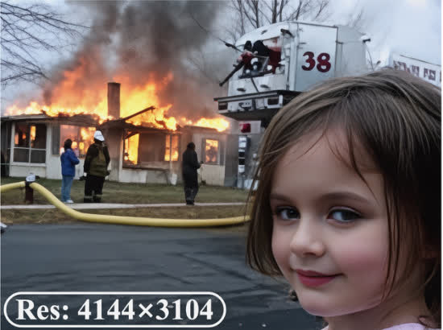
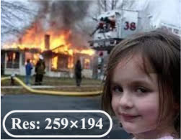
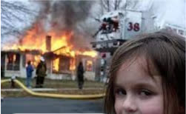


?
Profile Module
P
Perception Agent
R
Restoration Agent
4K
Stage 1: Image Analyzer
Task 1
Face
Execution
Rollback
VLM
if low
quality
P
Preference
Profile
Quality
scores
Reflection
if SR
Re-Plan
Stage 2: Degradation Reasoning
& Task Planning
Face Restoration
Description
Task 2
Restoration Plan
⋮
Task K
Stage 1
Task 1
Super-Resolution
Task 2
Denoising
Task 3
Super-Resolution
★
★
★
CLIPIQA+:
0.6344
TOPIQ:
0.5907
Task 1 Super-Resolution
MUSIQ:
62.9828
Expert IQA
NIQE:
3.5966
Quality Scores
Execution
Face Crop
Q–MoE
Face Restoration
Stage 2
Experience
Description
Tool 1
Tool 2
Tool N
Tool 1
Tool 2
Tool N
"A young girl with
long brown hair, …
firefighting efforts."
Agenda
…
…
VLM
["DN", "SR", "SR"]
VLM
↕
Distortion
["Noise", "LR", "LR"]
Description
Score-based Select for face
"Noise"
+
"LR"×2
Reflection
Score-base Select
Face Q–MoE
Upscaling Setting for 4K
High quality ?
Paste
Best Face from
Tool 1
No
☺
Output
Restoration Plan
Rollback
(0.927,
Super-Resolution
Denoising
Super-Resolution
Tool 4

Slide 2
