Slide 1
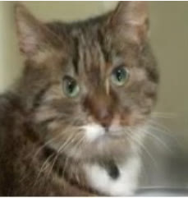
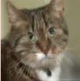
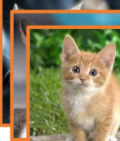
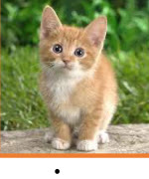
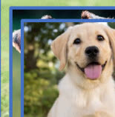
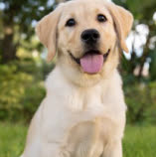
Rematching
gω
Param.
Pool P
t̂s
Classifier gθg
⋯
Inference
Class ŷ
Testing sample
Initial Matching
Task
ID t̂f
Rematching
Pretrained hₚₜₘ
⋮
Task ID t̂s
MLP
Direct
Selected p
Yes
t̂f ≠ t̂s
No
Pretrained hₚₜₘ
pₜ̂s
pₜ̂f
Classifier gθg
Direct
d
T₁
T₂
T₃
⋯
Tₜ₋₁
⋯
Distribution d̂
Training
W₁
W₂
Wₖ
top-K
Old feature space
Confidence E
Task-t training data
{T₁, T₃, T₄ ⋯ Tⱼ}
Confidence-based
⋮
ℒCTRD
E < τ
Param.
Pool P
Yes
CTRD
⋯
t̂s = argmax E(x; pᵢ)
i ∈ Γ
Wₜ
New feature space

Slide 2
