Slide 1



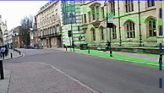
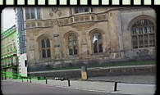
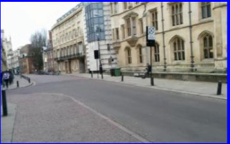



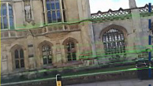
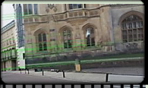


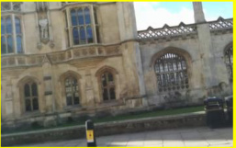








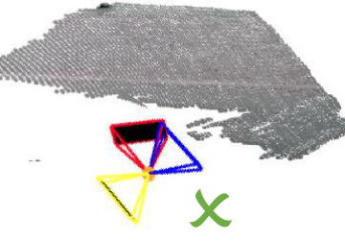
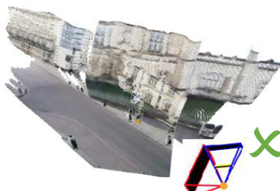
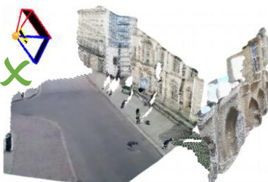
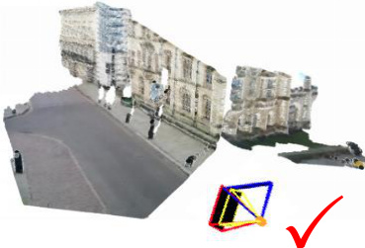
Hybrid Video Generation
Feature Matching Selector
Input Image Pair
Robust Relay
Frame Generation
Pose-Guided
Video Refinement
❄
❄
DynamicCrafter
ViewCrafter
…
…
…
: Matched Inlier Count
: Start Frame
: Addition
Top k
: End Frame
❄
: Frozen Network
…
Video Clip
Relay Frame
Hybrid Video
Pose Model (e.g. DUSt3R)
Pose Model (e.g. DUSt3R)
Pose Model (e.g. DUSt3R)

Slide 2
