Slide 1
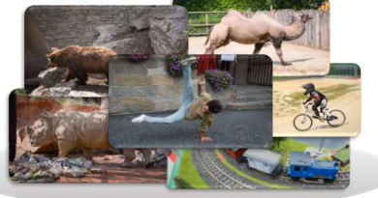






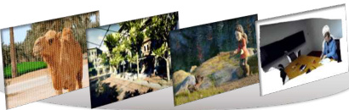


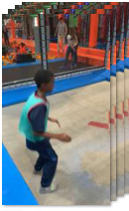
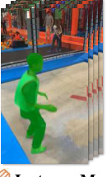
Stage 1 : Generating Metric-scale Camera, Video Depth, Object Category, Object Mask and Size
▤
Raw Data Collection
♟
Powerful Foundation Models
⚑
Data Filter Strategy
♟
Dynamic Bundle Adjustment
1
Proximal Depth Verification
Dynamic Masking
2
Dynamic Object Coverage
UniDepth-V2
SegAnyMo
♒
Coarse Camera Initialization
3
Focal-Length Stability
4
Video Blur Degree
Random
forest
▧
Raw 2D video datasets with GT
instance mask & semantic label
UniMatch
CoTracker-V3
5
Camera Motion Smoothness
Static Area
Bundle Adjustment
6
VLM Judgement
◩
Moving Object Recovery
Non-Rigid
Bundle Adjustment
SAM2 & Variants
VGGT
1
VLM-based object recognition
2
Semantic-based Segmentation
Sliding Window
Global Refinement
Raw dynamic 3D datasets
with GT camera & depth
3
Physical-aware Size Extraction
Epipolar Errors
Language Models
Stage 2 : Generating Finer-grained Captions For Moving Objects, Cameras and Dynamic Scenes
▣
Moving Object Caption
◆
Dynamic Scene Caption
◆
Camera Motion Caption
Prompt: Given the <raw video>, <moving instance mask> and
Prompt: Given the <raw video>, <moving instance masks> and
Prompt:
Given the <raw video>,
<instance label>. Provide a description of the moving instance.
<instance label> and <moving instance caption>. Describe the dynamic scene.
<instance label>, <moving instance
Focus on its action and attributes (e.g., color, shape, material).
Focus on scene type, instance-scene interaction, motion pattern, etc.
caption>, and <dynamic scene
Response (object-level)
Response (scene-level)
caption>. Provide a description of
<think> Alright, let's break down the attributes step by
<think> Alright, let's break down the attributes step by step:
the camera motion.
step: First, observe the boy's action: stand, crouch, ...
First, identify the scene type: an indoor trampoline park, ...
Then, see the boy's attire: light green shirt, ... Next,
Then, note the primary interactive entities: a young boy, ...
Response
note the shape and movement: agile, ... Then, consider
Next, observe the instance's motion patterns: jumps, spins, ...
<answer> {
the material of the clothing: lightweight, ... Finally,
Then consider the static background components: padded walls, ...
▣
Raw Videos
take into account the setting and engagement. </think> <answer>
Finally, take into account the spatial relationships and
The camera smoothly
{...}</answer>
interactions among moving instances and the scene: the boy
pans right, tracking the
actively interacts with the trampoline by jumping and performing
subject from the side with
LLM-rephrased
various acrobatic actions. </think> <answer> {...}</answer>
minimal shaking.
LLM-rephrased
}</answer>
<answer> {
<answer> {
LLM-aligned
A young boy in a vibrant green vest with red
Inside a vibrant indoor trampoline park, a young boy in a
trim and dark pants performs a dynamic sequence.
turquoise shirt dynamically jumps, spins, and flips. Brightly lit,
<answer> {
Beginning in profile, they turn, extending arms and
the park features multiple trampolines with blue padding and
The camera smoothly pans
balancing on ready legs. Fluidly shifting from
colorful play structures like orange and red climbing frames.
right, tracking the
standing to a focused crouch, their movements
Other children in white and pink shirts enjoy the lively,
young boy in the indoor
▨
Instance Masks
display agility and control. The energetic sequence
energetic atmosphere as the boy's joyful acrobatics highlight
trampoline park with
concludes with them seated, relaxed yet purposeful,
the scene's playful activity and vibrant setting.
minimal shaking.
“A Young Boy”
embodying athleticism and grace throughout the
} </answer>
}</answer>
transitions.
T
Instance Label
} </answer>
Editable rebuild

Slide 2
