Slide 1
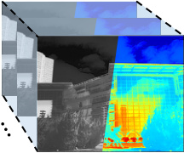
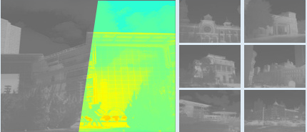
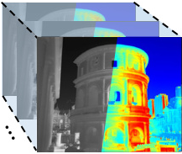
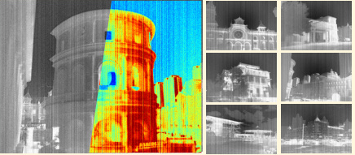
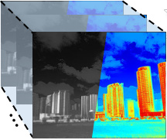
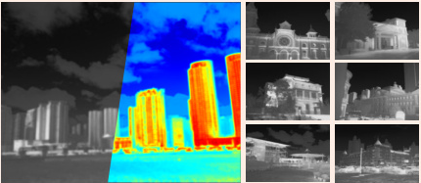
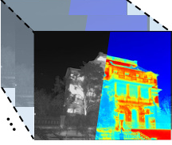
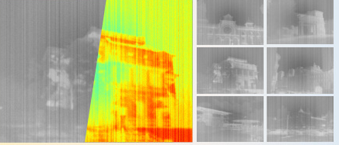
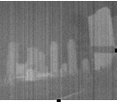

(a) Infrared Degradation Processing
Low Contrast
Noise
Contrast Degradation
Gaussian
Standard
Random
Blur
Mixture
k = 3
k = 5
k = 7
Gaussian Blur
Sequential Blending
(b) Dual Prompt Processing
(c) IR Multi-Degradation Restoration Network
(d) SPT
Degradation Descriptor
TP
≪
S
0
0
0
0
0
1
Iter.1
Nθ
N
Type/Degradation-specific
Prompts
0
Nθ
B
0
0
0
0
0
0
0
1
1
0
H
0
1×1×64
Degraded
Inf. Image
Restored
Inf. Image
Update
Prompt Fusion
Nθ
≪
C
Iterative
Iter.2
γ
β
Iter.2
×
+
+
+
Iter.3
N
0
0
0
0
0
1
B
0
0
0
0
1
0
Iter.n
Nθ
≪
N
IR Block
Nθ
B
C
Update
Nθ
≪
C
DSP
Selective Progressive Training(SPT)
S
Single Degraded
H
Hybrid Degraded
N
B
C
DSP:
Degradation-specific Prompts
TP:
Type Prompt
FP
BP
Parameter update
Noise
Blur
Contrast

Slide 2
