Slide 1

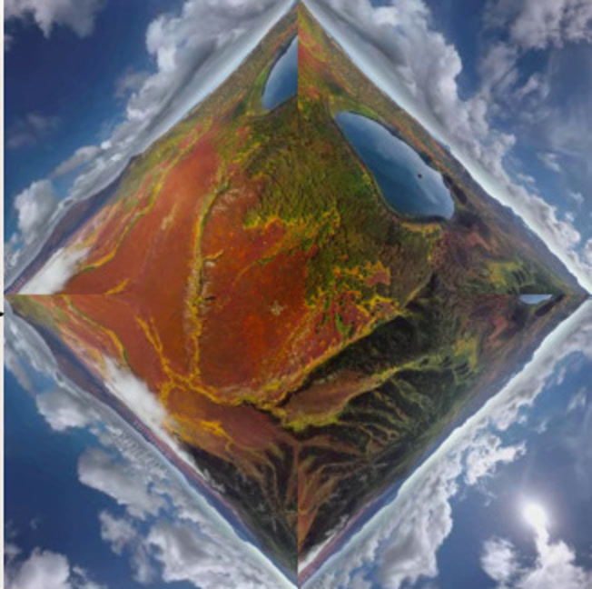
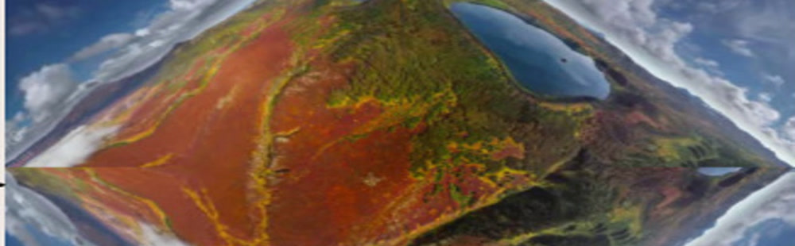

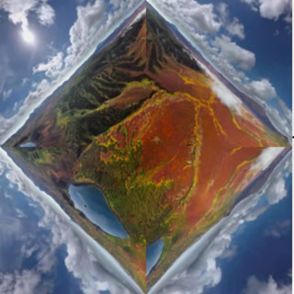
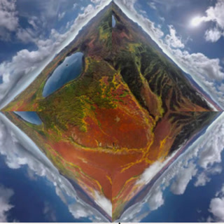



CubeMap
project
F
r
r*
r
r*
project
U
B
L
F
F
F
L
F
U
B
F
U
√2 a
a
R
R
B
R
Equirectangular Map
U
remap
ViewPoint Map
add noise
Pano Attention
Perspective Attention
Input
L
concat
L
F
Attn
F
Attn
B
R
Block
Block
B
Projected Input Perspective Video
R
× N
Output
Mask
Prompt

Slide 2
