Slide 1
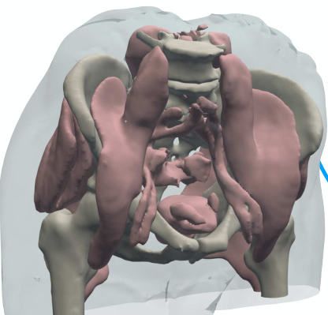
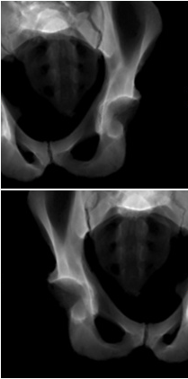
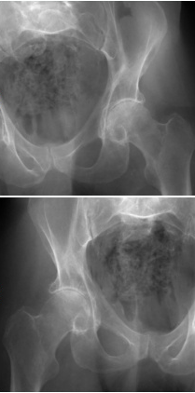
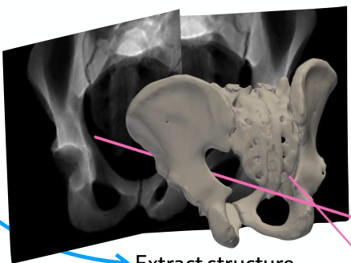
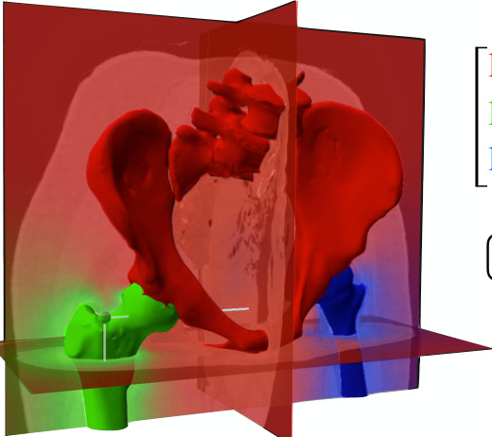
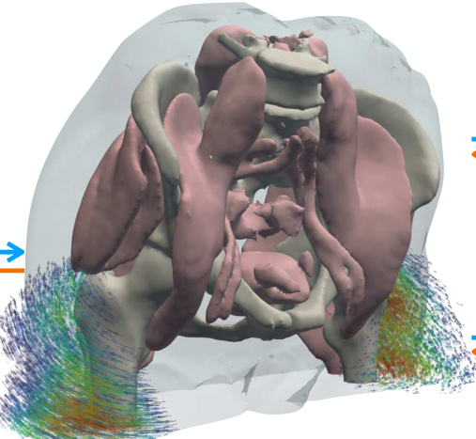
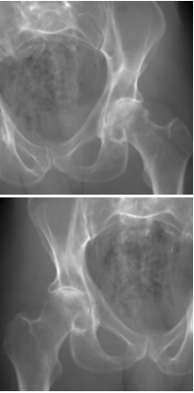
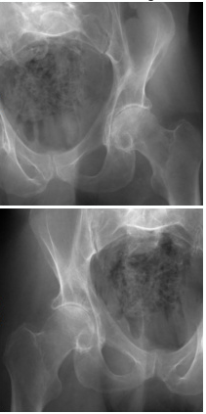
(A)
Stage 1:
Estimate the pose (Π̂) of each X-ray image
Operation flow
Gradient flow
Rendered X-ray
Real X-ray
𝒫(Π̂₁)
ℒ
Diff. X-ray
renderer
Eq. (3)
𝒫(Π̂₂)
ℒ
Diff. X-ray
renderer
Extract structure
Eq. (3)
S
anchor
⊙ V
Π̂₁
Π̂₂
Preoperative CT (V)
(B)
Stage 2:
Optimize structure-specific poses ( ) to estimate the polyrigid deformation field (Φ)
𝒫
Projection operator
ξ̂
Articulated poses
ℒ
Image loss function
Π
Camera matrix
ξ̂
Rendered X-ray
Real X-ray
log( )
log( )
𝒫(Π̂₁)
ℒ
log( )
Diff. X-ray
renderer
Eq. (3)
Eq. (7)
exp(W ξ̂)
𝒫(Π̂₂)
ℒ
0.24
Diff. X-ray
renderer
0.75
Eq. (3)
Eq. (7)
0.01
Precompute weight field W
W(x)
Sample deformation field Φ and warp V
Eq. (6)
Eq. (4)

Slide 2
