Slide 1
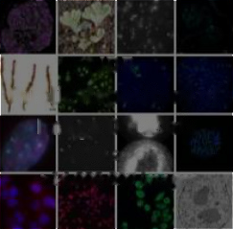
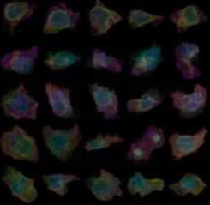
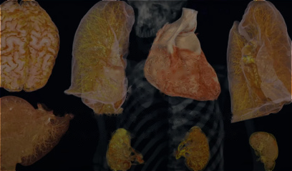
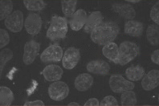
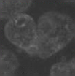
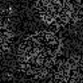
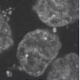
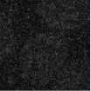
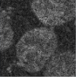
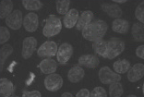
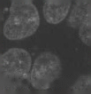
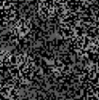
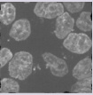
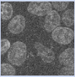
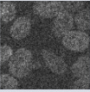

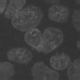
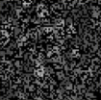
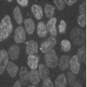
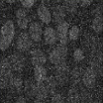
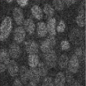
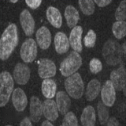
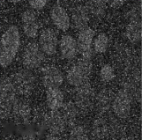
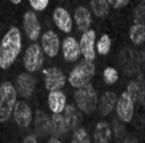

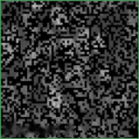
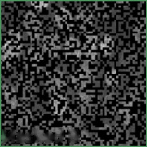
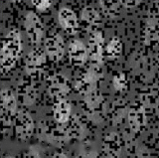
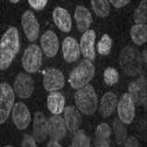
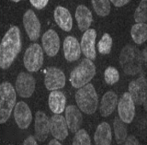
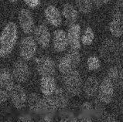
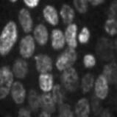

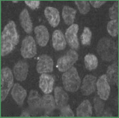
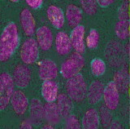
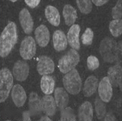
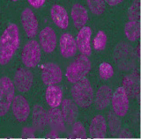
1 Raw Data Sampled
12 Combo
Masked
Deformed
Noisy
Low-Res
2/3D selection
IDR
hiPSC
HiP-CT
window
Public Repository of
Single-cell Image
Human Organ
Local
Image Datasets
Dataset
Atlas
Raw
>100 studies
>200,000 cells
>150 patients, >10,000 samples
>14,000,000 images
25 cellular structures
5 organ types, 6 Imaging Scale
••• •••
1/2
Mid-range
Raw-level Dataset, 2-5D dimensionality, MB-TB level file size
Multi-modal, Multi-dimensionality Dataset with Random Multi-scale Sampling (RMS)
1/4
Global
Task: Image Restoration
Task: Image Fusion
Mamba
Mamba
Random
Encoder
Random
Encoder
Noise
Masking
Raw
Noisy
Conv
Restored
Raw
Masked A
Masked B
Visible A&B
Conv
Fuse+Reconed
Decoder
Decoder
Task: Image Super-resolution
Task: Image Registration
Mamba
Mamba
Random
Encoder
Random
Encoder
Low-Res
Deforming
Raw
Downsampled
Conv
Upsampled
Raw
Deformed
Error Map
Conv
Registrated
Error Map
Decoder
Decoder
Task-related Joint-embedding Pre-training (TJP) on Multi-head Hierarchy Mamba2 (MHM)
Misalign
Align

Slide 2
