Slide 1
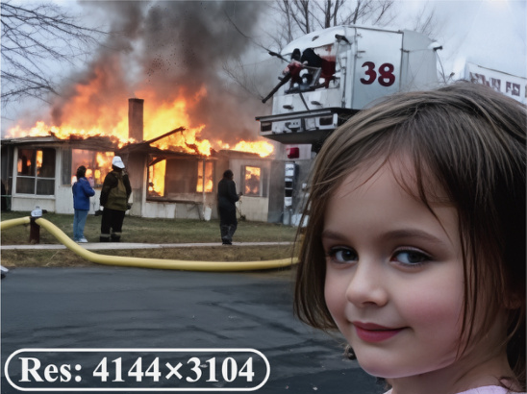
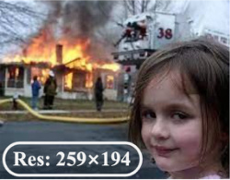


?
P
rofile Module
P
P
erception Agent
R
R
estoration Agent
4K
Task 1
Face
Stage 1:
Image Analyzer
Execution
Rollback
VLM
Quality
scores
if low
quality
P
Preference
Profile
Reflection
Re-Plan
Stage 2:
Degradation Reasoning
if SR
Face Restoration
& Task Planning
!
Description
Task 2
Res: 259×194
Restoration Plan
Task K
Res: 4144×3104
Stage 1
Task 1
Super-Resolution
Task 2
Denoising
Task 3
Super-Resolution
CLIPIQA+: 0.6344
TOPIQ: 0.5907
MUSIQ: 62.9828
NIQE: 3.5966
Task 1 Super-Resolution
Expert IQA
Quality Scores
Face Crop
Execution
Q-MoE
Face Restoration
Stage 2
Description
Experience
!
Tool 1
Tool 2
Tool N
Tool 1
Tool 2
Tool N
"A young girl with
long brown hair, …
firefighting efforts."
Agenda
…
…
["DN", "SR", "SR"]
VLM
["Noise", "LR", "LR"]
VLM
Distortion
Distortions
!
Description
Score-based Select for face
Quality Scores
"Noise"
+ "LR"×2
Reflection
Score-base Select
Face Q-MoE
Upscaling Setting for 4K
Paste
Best Face from
Tool 1
High quality ?
Restoration Plan
No
Output
Rollback
(0.927,
)
Super-Resolution
Denoising
Super-Resolution
Tool 4

Slide 2
