Slide 1
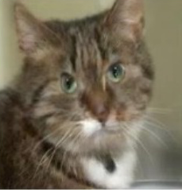
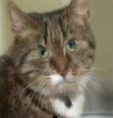
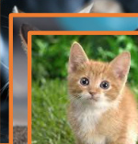
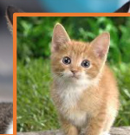
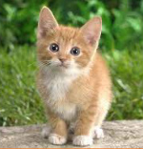
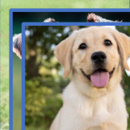
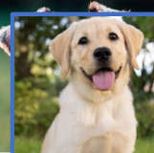
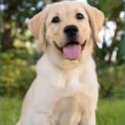
Rematching
𝑔
Classifier
𝑔
𝜔
Param.
𝑡
𝜃
𝑠
𝑔
Inference
Pool
𝑃
Class
𝑦
Initial Matching
Testing sample
Pretrained
Rematching
Task
Task ID
𝑡
Direct
MLP
𝑠
ID
𝑡
Selected
𝑝
𝑓
ℎ
Yes
No
𝑝𝑡𝑚
𝑡
≠
𝑡
Pretrained
ℎ
𝑓
𝑠
𝑝𝑡𝑚
𝑝
𝑝
𝑡
𝑠
𝑡
𝑓
Classifier
𝑔
𝜃
𝑔
𝑇
𝑇
𝑇
𝑇
Direct
𝑑
1
2
3
⋯
𝑡−1
Training
⋯
Distribution
𝑑
𝑊
1
𝑊
Confidence-based
top-K
𝑊
2
𝐾
Old feature space
Confidence
𝐸
Task-t training data
{
𝑇
,
𝑇
,
𝑇
⋯
𝑇
}
1
3
4
𝑗
ℒ
𝐶𝑇𝐼𝑅𝐷
𝐸 < 𝜏
Yes
CTIRD
Param.
Pool
𝑃
𝑊
𝑡
=𝑎𝑟𝑔𝑚𝑎𝑥 𝐸(𝑥;𝑝
)
𝑡
𝑠
𝑖
New feature space
𝑖
∈ Γ

Slide 2
