Slide 1



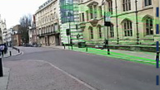
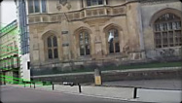
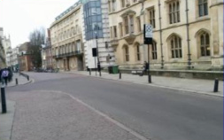



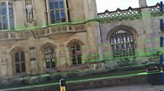
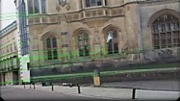


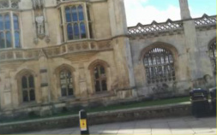












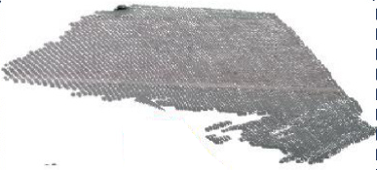
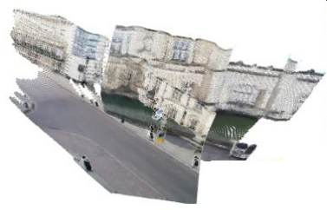
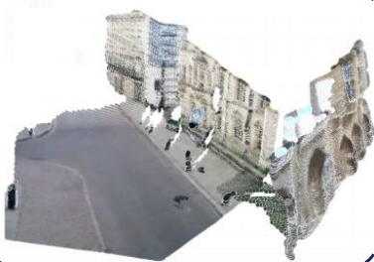
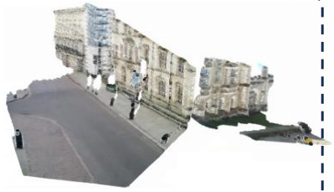
Hybrid Video Generation
Feature Matching Selector
Input Image Pair
Robust Relay
Pose-Guided
Frame Generation
Video Refinement
DynamiCrafter
…
ViewCrafter
…
…
: Matched Inlier Count
: Start Frame
: Addition
Top k
: End Frame
: Frozen Network
…
Video Clip
Relay Frame
Hybrid Video
Pose Model (e.g. DUSt3R)
Pose Model (e.g. DUSt3R)
Pose Model (e.g. DUSt3R)
Notes:
Reconstructed from the supplied reference image. All text, region boxes, arrows, film borders, perforations, camera wireframes and result annotations are editable PowerPoint objects. Photographs and point-cloud renderings are individual embedded images. Source aspect ratio: 1881 × 986.

Slide 2
