Slide 1
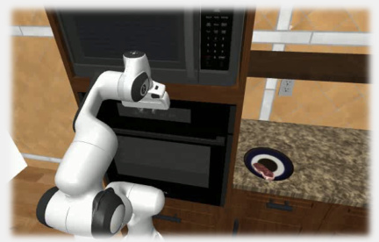
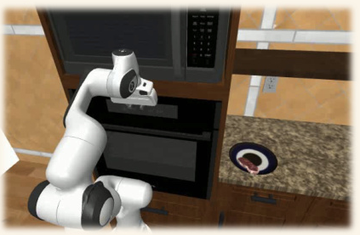
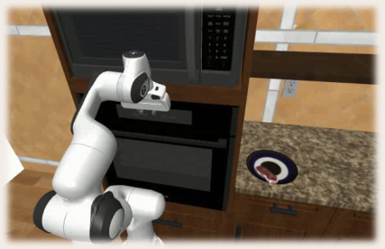
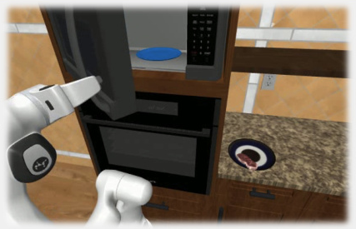
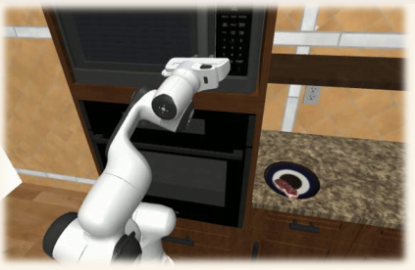
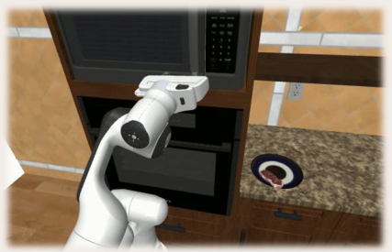
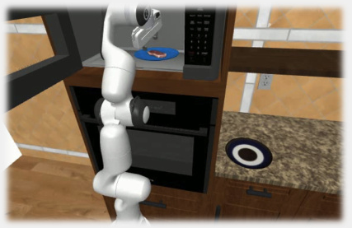
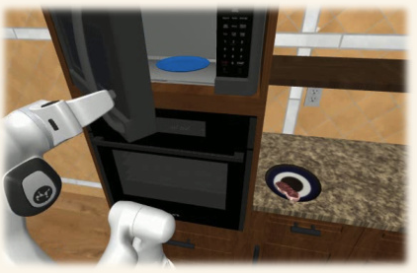
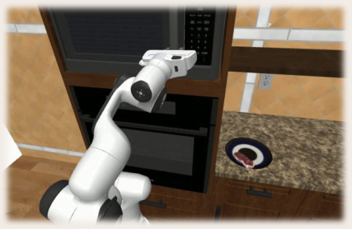
Task: “Thaw the steak in the microwave”
Task: “Grasp door handle”
Task: “Open microwave door”
[
o
]
[
o
]
[
o
]
ϕ
0
0
0
ϕ
The gripper is in front of microwave...
The gripper is in front of microwave...
The gripper is in front of microwave...
Task progress: 0%
The robot needs to: “Grasp door handle”
The robot needs to: “Open microwave door”
[
o
]
[
o
]
[
o
1
]
14
9
The robot fully grasped the door handle.
The gripper moved closer to the door...
The robot opened the microwave door.
Task progress: 40%
The robot needs to: “Pull door open”
The robot needs to: “Put steak in microwave”
ψ
ψ
[
o
31
]
[
o
]
14
[
o
9
]
The robot put the steak in the microwave.
The robot opened the microwave door.
Task is complete.
The robot needs to: “Close microwave door”
The robot fully grasped the door...
Task progress: 100%
Task is complete.
Notes:
Reconstructed from the provided reference. Text, time-step labels, panels, arrows, φ/ψ symbols and ellipsis dots are native editable objects. Nine robot scenes are separate original raster crops. The last completion line is shifted slightly upward to avoid the source image clipping.

Slide 2
