Slide 1



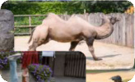










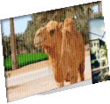
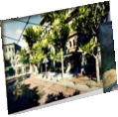
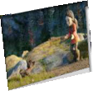
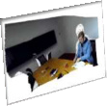





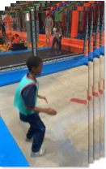



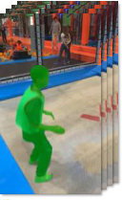



Stage 1 : Generating Metric-scale Camera, Video Depth, Object Category, Object Mask and Size
Raw Data Collection
Powerful Foundation Models
Data Filter Strategy
Dynamic Bundle Adjustment
1
Proximal Depth Verification
Dynamic Masking
2
Dynamic Object Coverage
UniDepth-V2
SegAnyMo
3
Focal-Length Stability
Coarse Camera Initialization
4
Video Blur Degree
Random
5
forest
Raw 2D video datasets with GT
UniMatch
CoTracker-V3
Camera Motion Smoothness
Static Area
instance mask & semantic label
6
VLM Judgement
Bundle Adjustment
Moving Object Recovery
Non-Rigid
SAM2 & Variants
VGGT
Bundle Adjustment
1
VLM-based object recognition
2
Semantic-based Segmentation
Sliding Window
Raw dynamic 3D datasets
Global Refinement
with GT camera & depth
Epipolar Errors
Language Models
3
Physical-aware Size Extraction
Stage 2 : Generating Fine-grained Captions For Moving Objects, Cameras and Dynamic Scenes
Moving Object Caption
Dynamic Scene Caption
Camera Motion Caption
Prompt: Given the <raw video>
, <moving instance mask>
and
Prompt: Given the <raw video>
, <moving instance masks>
, <instance label>
T
Prompt: Given the <raw video>
<instance label>
T
. Provide a description of the moving instance.
and <moving instance caption>
. Provide a description of the dynamic scene.
<instance label>
T
, <moving instance
Focus on its action and attributes (e.g., color, shape, material).
Focus on the scene type, instance-scene interaction, instance’s motion pattern, etc.
caption>
, and <dynamic scene
Response (object-level)
Response (scene-level)
caption>
. Provide a description of
<think> Alright, let's break down the attributes step by
<think> Alright, let's break down the attributes step by step:
the camera motion.
step: First, observe the boy’s action: stand, crouch, ... .
First, identify the scene type: an indoor trampoline park, ... .
Then, see the boy’s attire: light green shirt, ... . Next,
Then, note the primary interactive entities: a young boy, ... .
Response
note the shape and movement: agile, ... . Then, consider
Next, observe the instance’s motion patterns: jumps, spins, ....
<answer> {
the material of the clothing: lightweight, ... . Finally,
Then consider the static background components: Padded
The camera smoothly
Raw Videos
take into account the setting and the boy's engagement:
Walls, ... . Finally, take into account the spatial relationships and
pans right, tracking the
indoor trampoline park, ... .</think>. <answer> {...} </answer>
interactions among different moving instances and the scene: the
boy actively interacts on the trampoline by jumping and
subject from the side with
LLM-rephrased
performing various acrobatic actions. </think>. <answer> {...} </answer>
minimal shaking.
LLM-rephrased
}</answer>
<answer> {
A young boy in a vibrant green vest with red
<answer> {
LLM-aligned
trim and dark pants performs a dynamic sequence.
Inside a vibrant indoor trampoline park, a young boy in a
Beginning in profile, they turn, extending arms and
turquoise shirt dynamically jumps, spins, and flips. Brightly lit,
<answer> {
balancing on ready legs. Fluidly shifting from
the park features multiple trampolines with blue padding and
The camera smoothly pans
standing to a focused crouch, their movements
colorful play structures like orange and red climbing frames.
right, tracking the young boy
Instance Masks
display agility and control. The energetic sequence
Other children in white and pink shirts enjoy the lively,
in the indoor trampoline
concludes with them seated, relaxed yet purposeful,
energetic atmosphere as the boy's joyful acrobatics highlight
park with minimal shaking.
embodying athleticism and grace throughout the
the scene's playful activity and vibrant setting.
}</answer>
“A Young Boy”
transitions.
}</answer>
T
Instance Label
}</answer>
Notes:
Reconstructed from the supplied reference. All diagram text, frames, arrows, numbered steps and basic icons are editable PowerPoint objects. Photographs, model outputs and logos are individually embedded images. Canvas ratio: 1848:1360. Handwritten text font: Comic Sans MS; headings: Liberation Serif and DejaVu Sans.

Slide 2
