Slide 1

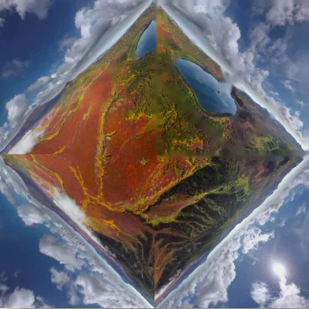

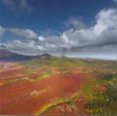
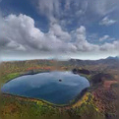
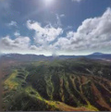
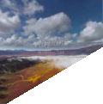
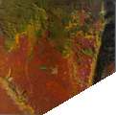

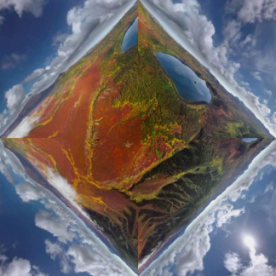





CubeMap
project
r
r*
r*
F
r
project
U
F
L
U
F
L
F
F
B
D
R
L
F
√2 a
a
B
R
U
R
B
U
Equirectangular Map
remap
ViewPoint Map
add noise
Perspective Attention
Pano Attention
Input
L
concat
L
F
Attn
Block
F
Attn
Block
B
R
B
Projected Input Perspective Video
R
×
𝒩
Output
Mask
Prompt
Notes:
Reconstructed from the supplied reference. All text, coloured facets, frames, projection guides, attention blocks, arrows and mask shapes are editable PowerPoint objects. Landscape photographs are independently replaceable embedded images.

Slide 2
