Slide 1
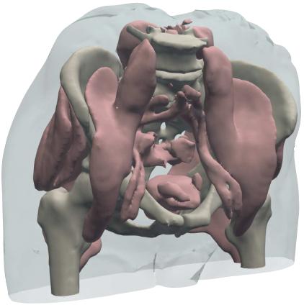
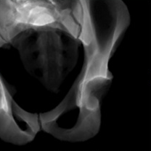
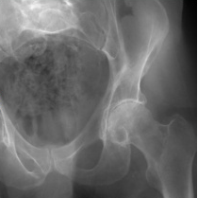
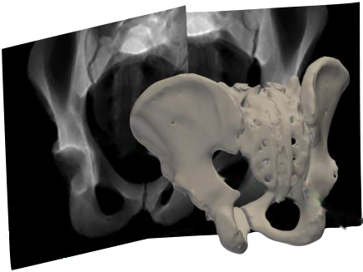
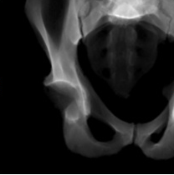
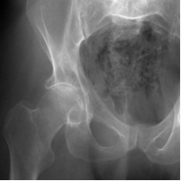
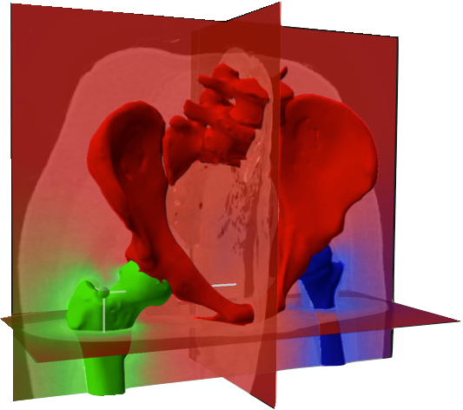
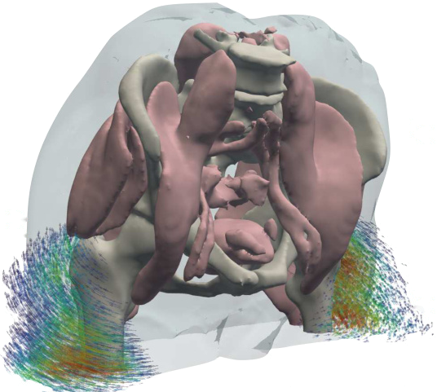
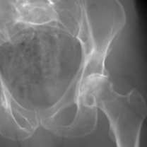
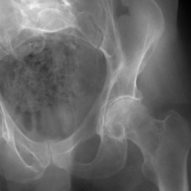
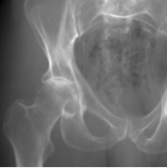
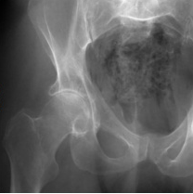
(A) Stage 1:
Estimate the pose (
Π
) of each X-ray image
Operation flow
Gradient flow
Rendered X-ray
Real X-ray
𝒫
Π
(
1
)
ℒ
Diff. X-ray
renderer
Eq. (3)
𝒫
Π
(
2
)
ℒ
Diff. X-ray
Extract structure
renderer
S
V
Eq. (3)
anchor
⊙
Π
Π
Preoperative CT (
V
2
)
1
(B) Stage 2:
Optimize structure-specific poses (
) to estimate the polyrigid deformation field (
Φ
)
𝒫
Projection operator
𝔗
Articulated poses
ℒ
Image loss function
Π
Camera matrix
𝔗
Rendered X-ray
Real X-ray
log(
)
𝒫
Π
log(
)
(
1
)
ℒ
log(
)
Diff. X-ray
renderer
Eq. (7)
Eq. (3)
exp(
W
)
𝔗
𝒫
Π
(
2
)
ℒ
0.24
Diff. X-ray
renderer
Eq. (7)
0.75
Eq. (3)
Precompute weight field
W
0.01
Sample deformation field
Φ
and warp
V
Eq. (6)
W
(x)
Eq. (4)
Notes:
Reconstructed from the supplied reference. All labels, mathematical symbols, arrows, panel borders, camera geometry and vector diagrams are editable PowerPoint objects. Twelve scientific image crops are embedded independently. Canvas: 1938 × 1210 reference pixels. Office fonts: Calibri, Times New Roman, Cambria Math. Compatible preview fonts: Carlito, Liberation Serif, Latin Modern Math.

Slide 2
