Slide 1
LENDING CLUB LOAN DEFAULTERS PREDICTION
Data Science engineering methods and tools
Bhagyashree Nair (002139969)
Shweta Wakale (001518127)
Anuprita Dhamale(001529811)

Slide 2
Implementation process
Our code consists of the following:
Data Description and Visualization
Exploratory Data Analysis
Data Pre-processing
Train Test Split
Models Building-
XGBoost Classifier
Random Forest Classifier
Deep Neural Networks (DNN)
Linear Regression

Slide 3
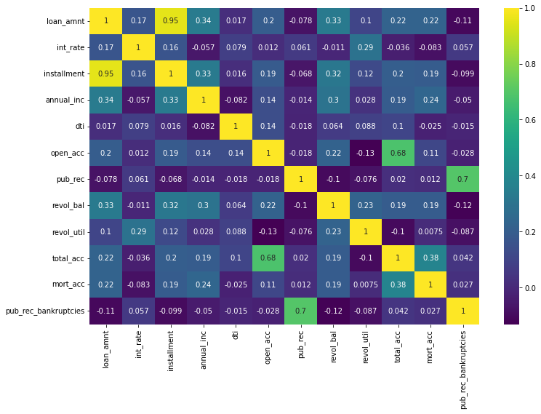
Data Analysis
Heatmap shows perfect correlation between "loan_amnt" the "installment" which his explored more in the code.

Slide 4
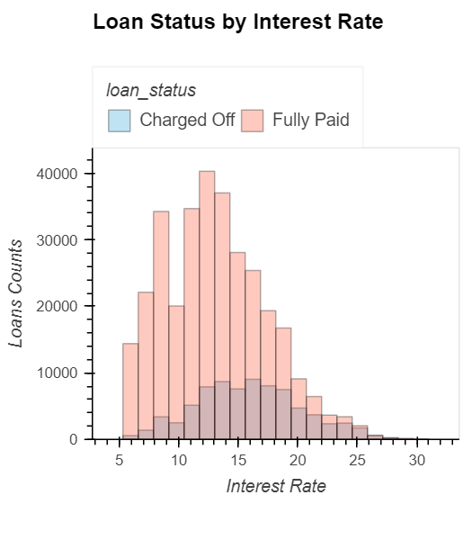
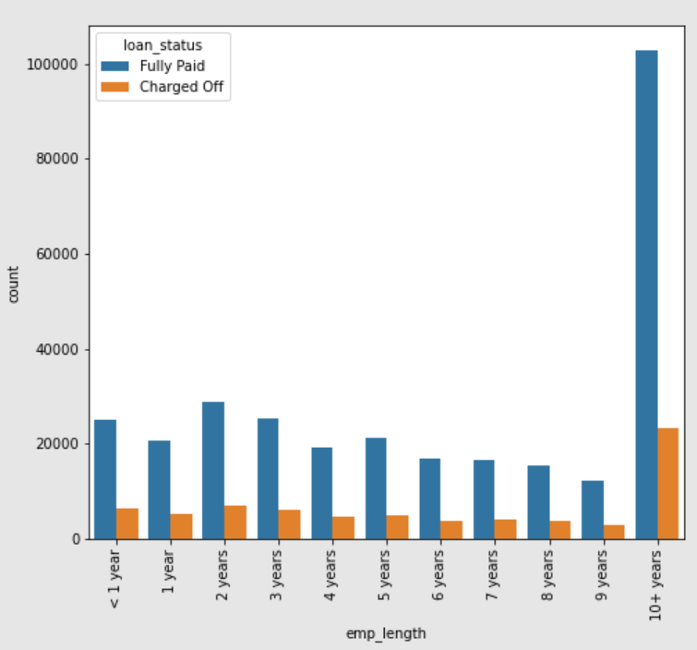
Data Analysis
To better understand the data, we plotted graphs showing the relationship between all the attributes in the dataset with the loan status. This helped us understand which attributes contributed more to our prediction.

Slide 5
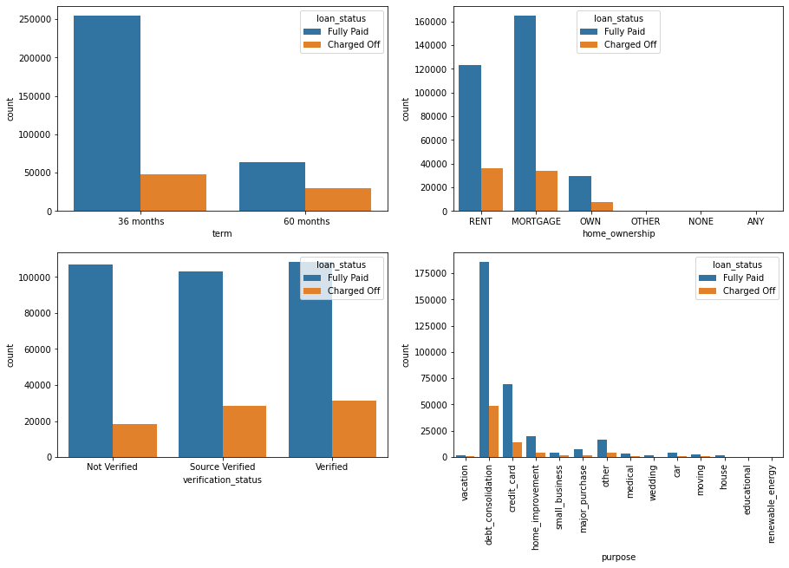
Data Analysis
Plots showing how attributes ‘term’, ‘home_ownership’, ‘verification_status’ and loan_purpose’ contribute to the loan status.

Slide 6
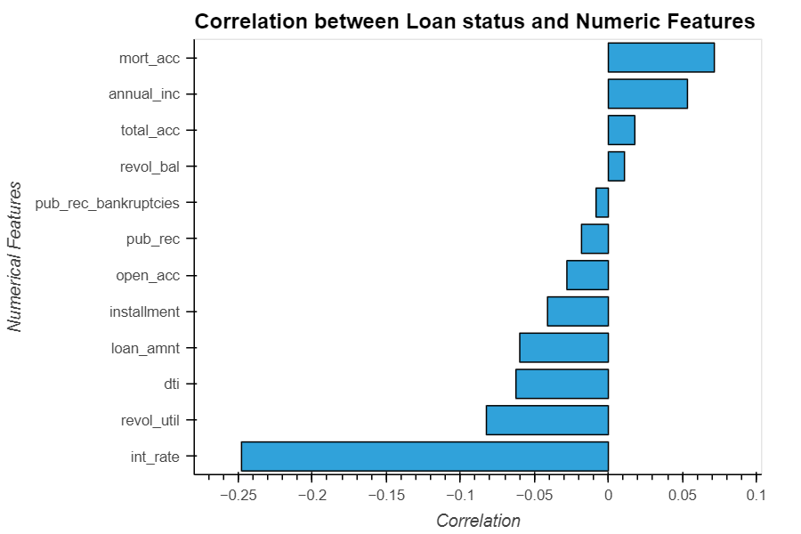
Data Analysis
Correlation between all the numeric features and loan status

Slide 7
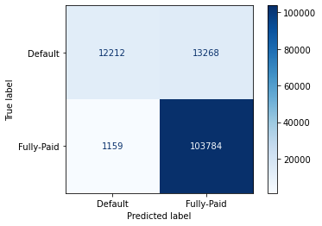
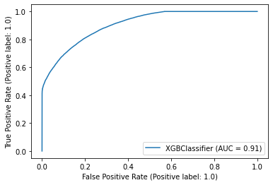
Gradient Boosting Classifier
Gradient boosting is a machine learning technique for regression and classification problems, which produces a prediction model in the form of an ensemble of weak prediction models, typically decision trees.
Boosting is a method of converting weak learners into strong learners. In boosting, each new tree is a fit on a modified version of the original data set.
The accuracy for the dataset using Gradient Boosting is 88.90%.

Slide 8

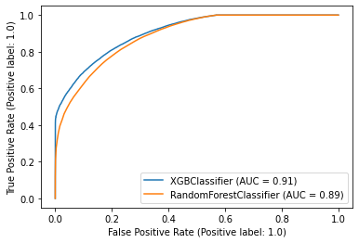
Random Forest Classifier
Used for both classification as well as regression.
We Used it to create decision trees on data samples and then gets the prediction from each of them and finally selects the best solution by means of voting.
The accuracy for the dataset using Random Forest algorithm is 95.49%

Slide 9
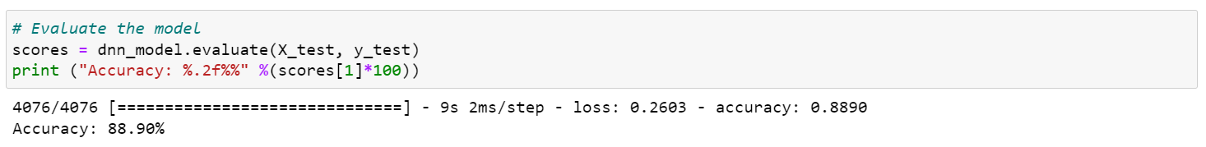
Deep Neural Network (DNN)
DNN is implemented by stacking layers of Neural Network along depth and width of smaller architecture.
Multiple layers allow models to become more efficient at learning complex features
The accuracy for the dataset using DNN algorithm is 88.90%

Slide 10
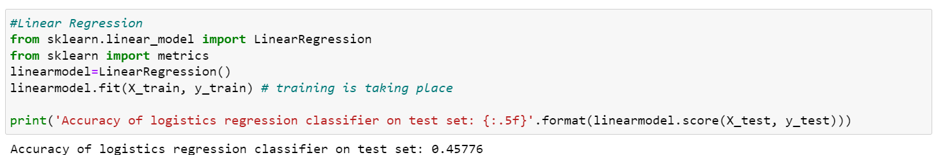
Linear Regression
Linear regression performs exceptionally well for linearly separable data
It is often prone to noise and overfitting
The accuracy for the dataset using Linear regression is 45.77%

Slide 11
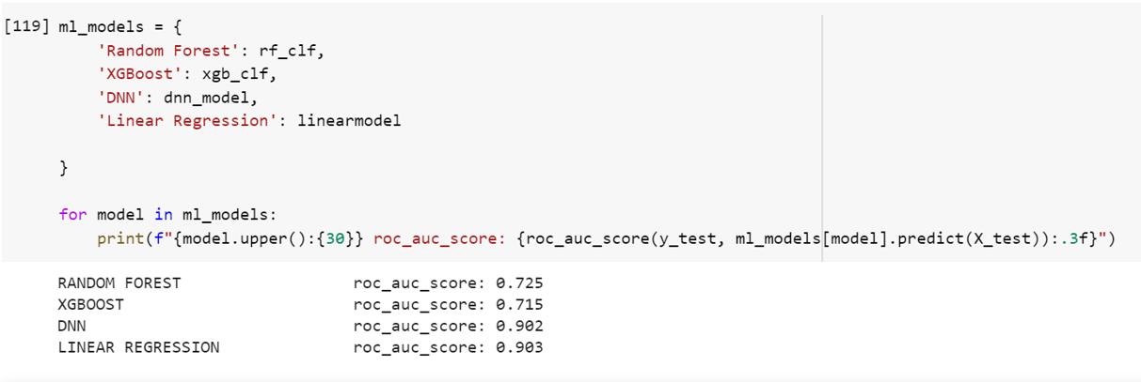
Results

Slide 12
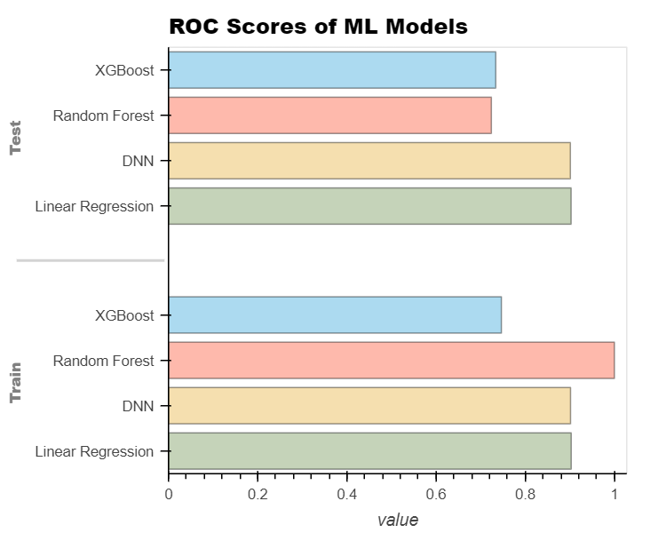
ROC Scores

Slide 13
Thank you!

