Slide 1

Process Mining with Domain Knowledge
Prabhakar (Alok) Dixit
prabhakar.dixit@philips.com
Joos Buijs, Wil van der Aalst, Bart Hompes, Hans Buurman
Notes:
Background about Philips flagship
Optimizing Healthcare Workflows
Healthcare data

Slide 2
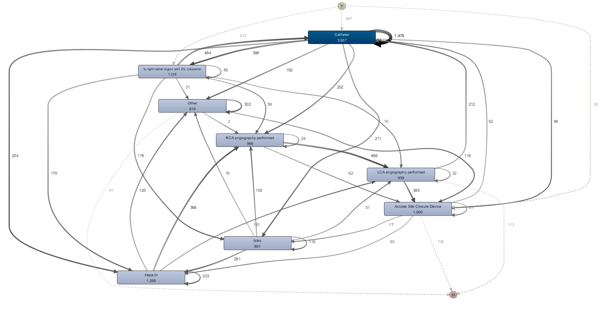

Motivation
Event Log
Process Model
Healthcare:
Incomplete data
Noisy data
Domain expert knows only some fractions/rules/constraints of the overall process
Notes:
Traditional process discovery : Event logs -> Discovery algorithm -> Process models
Problem: Healthcare data…
Way to incorporate domain knowledge

Slide 3
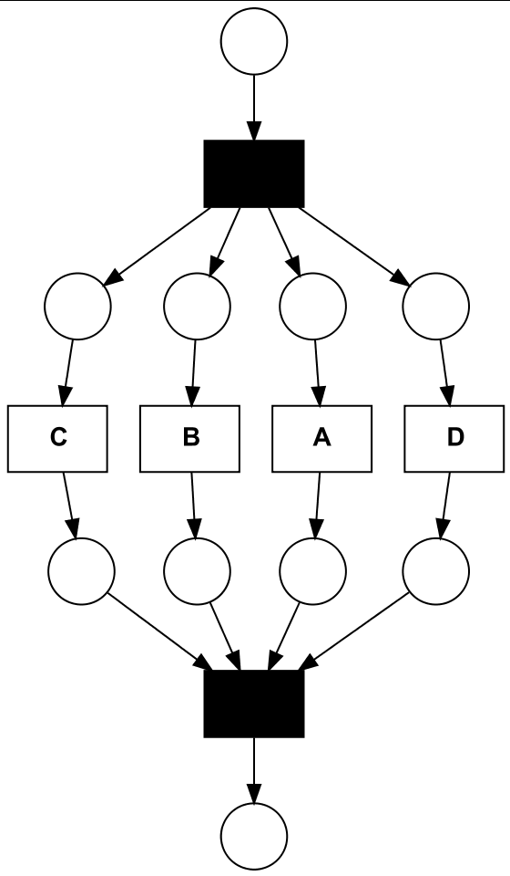
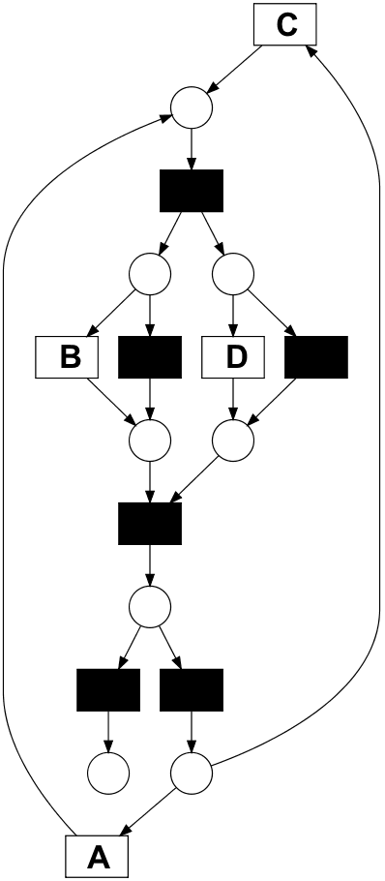

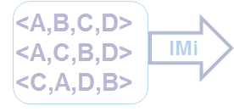
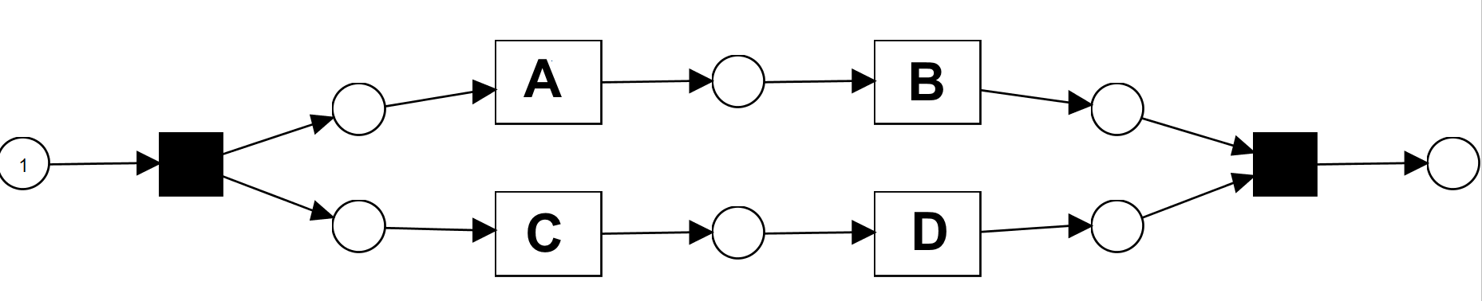
General Idea
Domain Knowledge
<A,B,C,D>
<A,C,B,D>
<C,A,D,B>
IMi

Slide 4
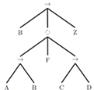
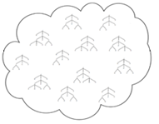


Outline
Replay Fitness, Precision, Simp., Gen.
Quality check
Pareto
Front
Optimal Models Selection
Input
Modification
Verification
Output

Slide 5
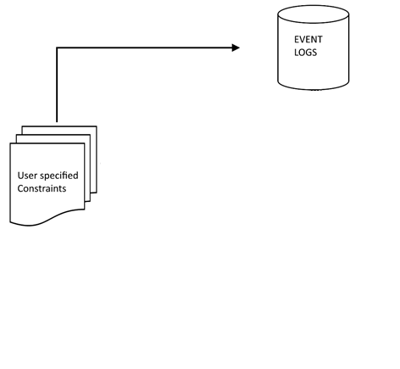

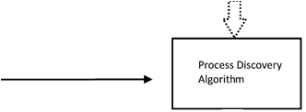
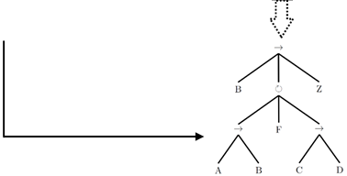
Possible Approaches
Notes:
The domain knowledge can be specified using constraints
Incorporated during any three stages of process mining
Event logs:
While event logging. For eg. While manually logging, provide some recommendations to make the data “process minable”. Don’t Force the user.
Event log post-processing
Process Discovery
Couple with already existing process discovery alogorithms : To give some weights for constraints for ex.
New algorithms considering both event logs and constraints
Model Post Processing
Post process a model to include user specified constraints
Our focus..

Slide 6
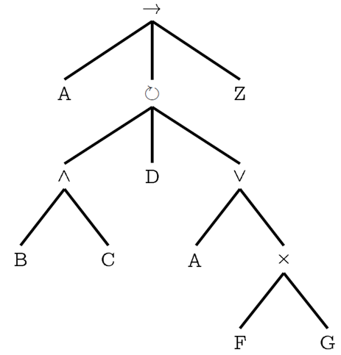
Process Trees
Sound and Structured
Five operators:
Seq
Loop
And
I-OR
X-OR
‘Seq’ and ‘Loop’ navigated from L to R
Order not fixed for other operators
Notes:
Process Trees as process models
Navigation : Seq and Loop L to R, And, Or, Xor : order doesn’t matter
Hierarchical structure allows us to construct a generic machinery

Slide 7
Domain Knowledge
User Specified Constraints
Using Declare templates
Response(A,B)
A is always eventually followed by B
Trace 1 : <…A,….B…>
Trace 2 : <…..B,……..>
Trace 3 : <..A………..>
Trace 4 : <..B,…..A...>
Other Constraints:
Precedence(A,B), Coexistence(A,B), Responded-existence(A,B), Not-Succession(A,B), Not-Coexistence(A,B), Existence(A,n1,n2)
Notes:
Use Declare constraints as a way to incorporate domain knowledge
Set of templates currently included
Example meanings..

Slide 8
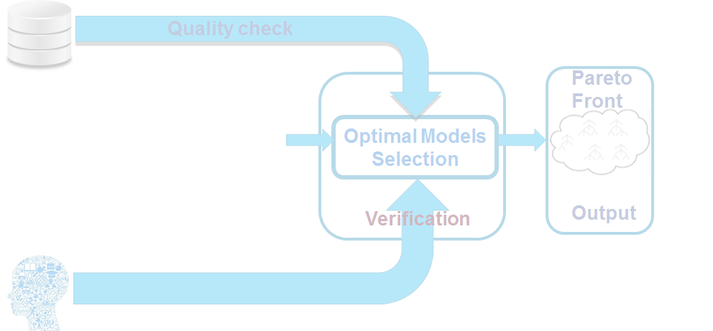
Outline
Input
Modification

Slide 9
Modification
“Brute force” modification approach
Three basic edit operations
Add Node
Remove Node
Modify Node
Explore the space until a certain depth
Maximum edit operations

Slide 10
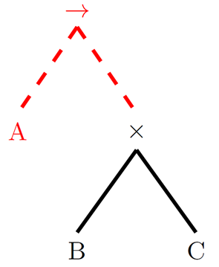
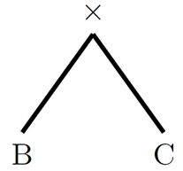
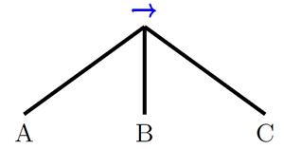
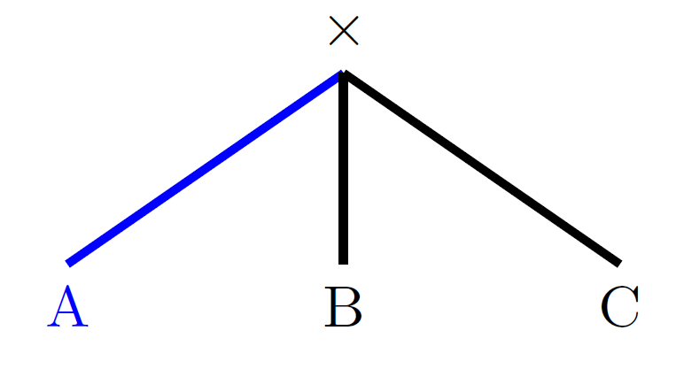
Modification Operations
Number of edits : 0
Number of edits : 1
Remove A
Add A
Number of edits : 3
Number of edits : 2
Modify XOR

Slide 11
Outline
All possible candidate trees:
Up to ‘n’ number of edits
Input
Modification

Slide 12
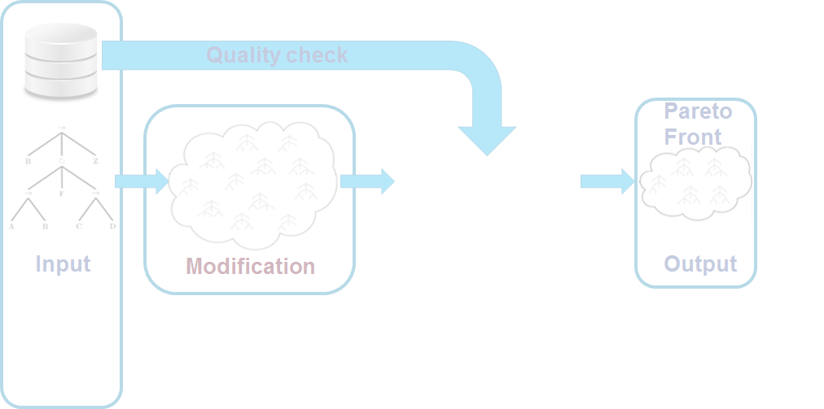
Outline
Optimal Models Selection
Verification

Slide 13
Constraint Verification
Sub-tree computation
Reduce computation space
Activity Occurrence
Verification
Verify if an activity is guaranteed to (not) occur
Check Operator type & position
Check if the common operator is valid

Slide 14

Constraint Verification
Sub-tree computation
Reduce computation space
Activity Occurrence
Verification
Verify if an activity is guaranteed to (not) occur
Check Operator type & position
Check if the common operator is valid

Slide 15
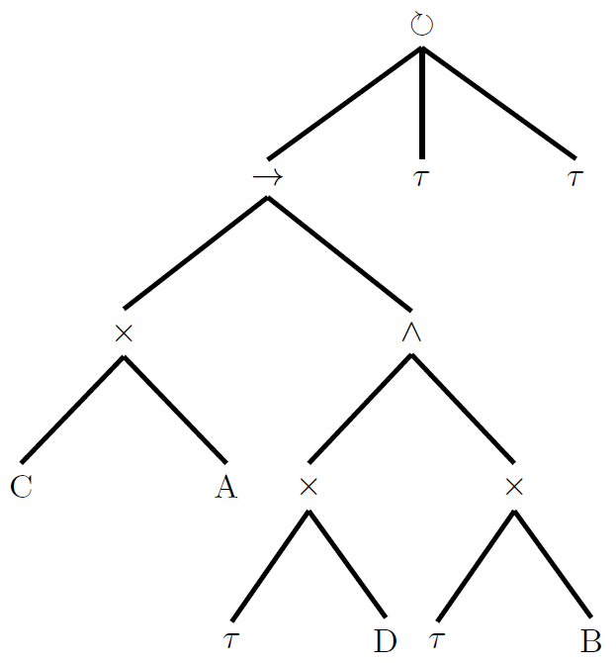
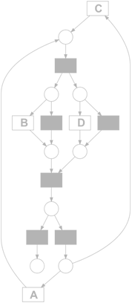
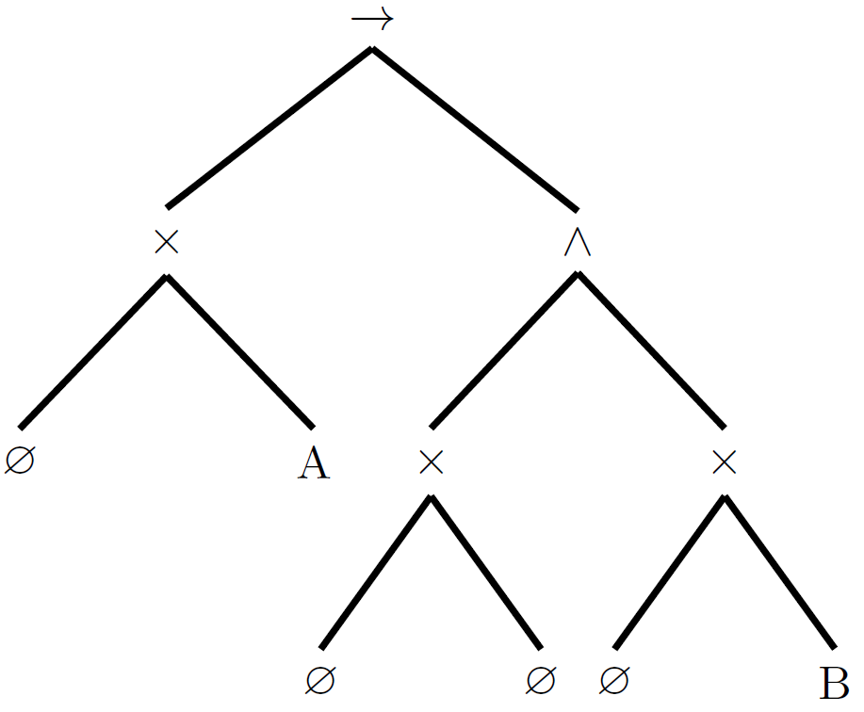
Sub-tree computation
<A,B,C,D>
<A,C,B,D>
<C,A,D,B>
<A,B,C,D>
<A,C,B,D>
<C,A,D,B>
Response(A,B) : A should eventually be followed by B

Slide 16
Constraint Verification
Sub-tree computation
Reduce computation space
Activity Occurrence
Verification
Verify if an activity is guaranteed to (not) occur
Check Operator type & position
Check if the common operator is valid

Slide 17
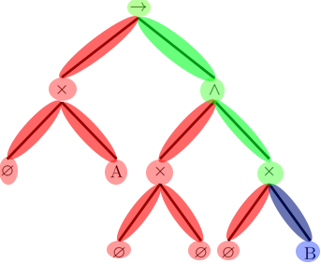
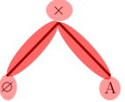
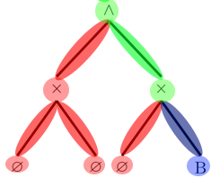
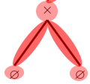
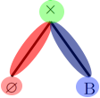
Activity Occurrence
Response(A,B) : A should eventually be followed by B
Always
Sometimes
Never

Slide 18
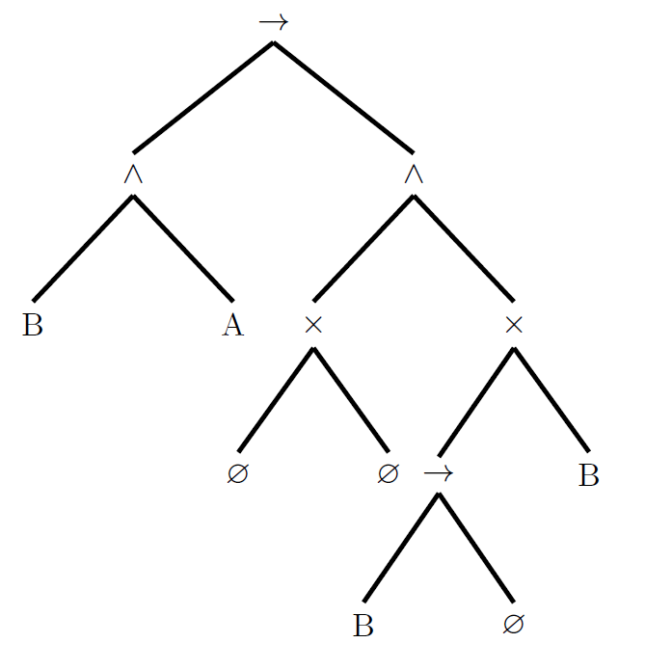
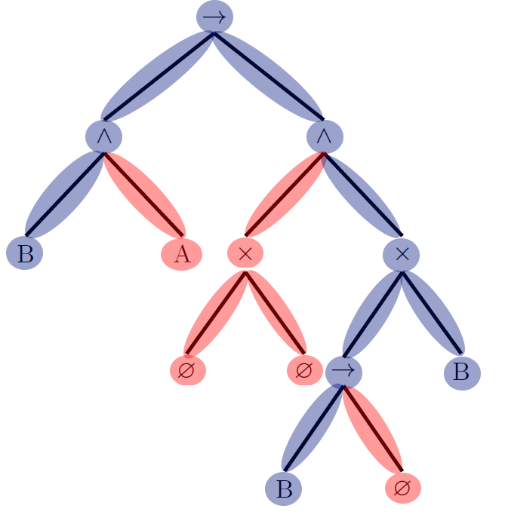
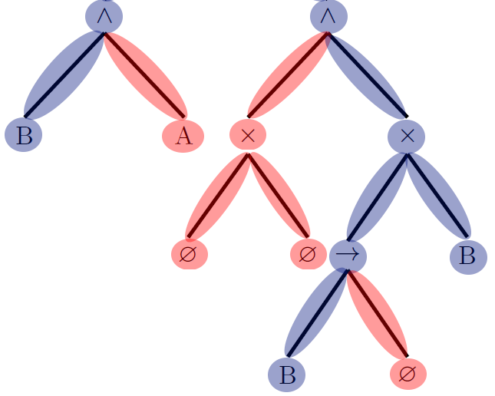
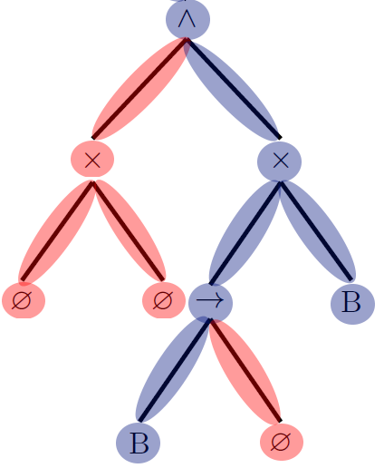
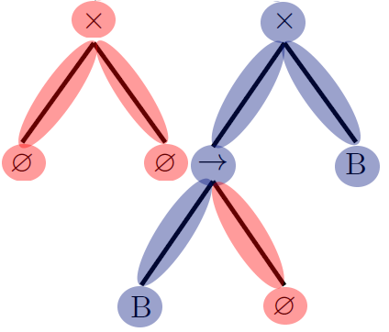
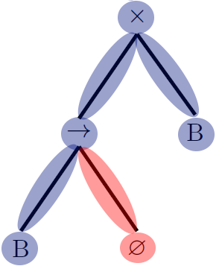
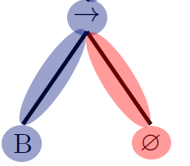

Activity Occurrence
Response(A,B) : A should eventually be followed by B
Always
Sometimes
Never

Slide 19
Constraint Verification
Sub-tree computation
Reduce computation space
Activity Occurrence
Verification
Verify if an activity is guaranteed to (not) occur
Check Operator type & position
Check if the common operator is valid

Slide 20
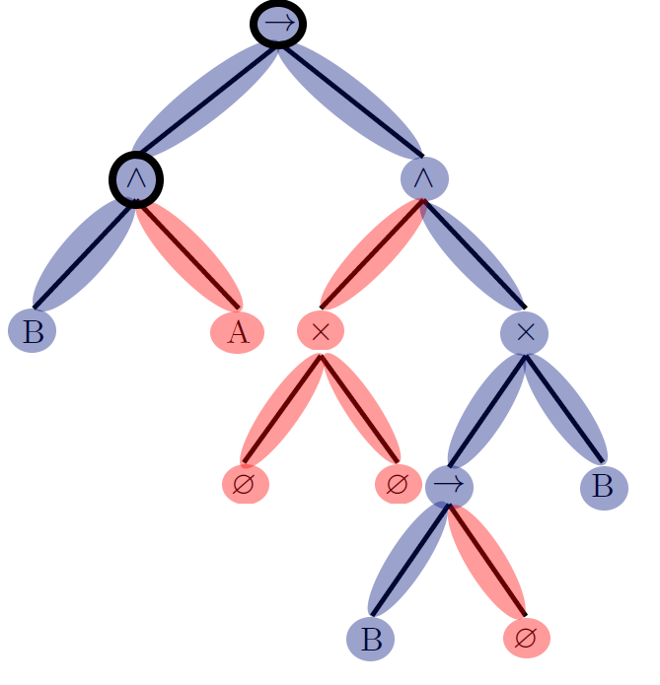
Operator & Position Verification
Check Operator type for each ancestor of A
Response:
Valid common parent operators:
(Seq) and (Loop)
Position : After ‘A’
Response(A,B) : A should eventually be followed by B
Always
Sometimes
Never

Slide 21
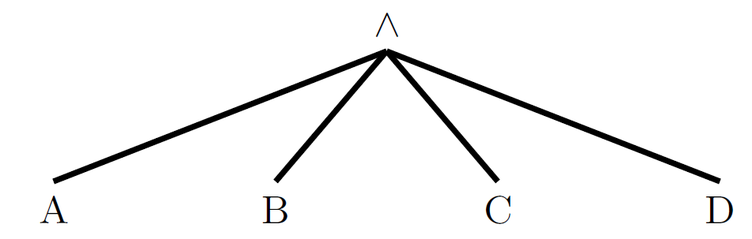
Evaluation : Synthetic
<A,B,C,D>⁹⁰,
<A,C,B,D>⁹⁰,
<A,C,D,B>⁹⁰,
<C,A,D,B>⁹⁰,
<C,A,B,D>⁹⁰,
<C,D,A,B>⁹⁰, <C,D,B,A>⁶,
<C,B,A,D>⁶,
<D,A,C,B>⁶
<A,B,C,D>⁹⁰,
<A,C,B,D>⁹⁰,
<A,C,D,B>⁹⁰,
<C,A,D,B>⁹⁰,
<C,A,B,D>⁹⁰,
<C,D,A,B>⁹⁰, <C,D,B,A>⁶,
<C,B,A,D>⁶,
<D,A,C,B>⁶
<A,B,C,D>⁹⁰,
<A,C,B,D>⁹⁰,
<A,C,D,B>⁹⁰,
<C,A,D,B>⁹⁰,
<C,A,B,D>⁹⁰,
<C,D,A,B>⁹⁰,
<C,D,B,A>⁶,
<C,B,A,D>⁶,
<D,A,C,B>⁶
Constraints:
response(A,B),
precedence(A,B),
response(C,D),
precedence(C,D)

Slide 22
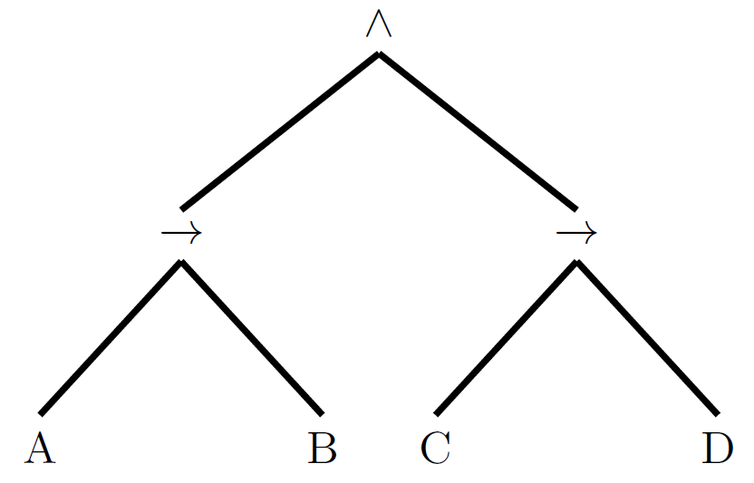
Evaluation : Synthetic
Constraints:
response(A,B),
precedence(A,B),
response(C,D),
precedence(C,D)
Tree | # Const | Fitness | Prec | Gen | Simp
Org | 0 | 1 | 0,833 | 0,96 | 1
Mod | 4 | 0,997 | 1 | 0,96 | 1
Number of edits: 2

Slide 23
Evaluation: Real-life Event Log
Road traffic fine management process
11 Event classes, 150,370 cases
1. Mine process tree using complete log
2. Learn domain rules based on this process tree
3. Filter log to contain 10% cases
6. Evaluate based on rules from step 2 & complete log
5. Create candidate trees using process tree from step 4
4. Create process tree from filtered log

Slide 24
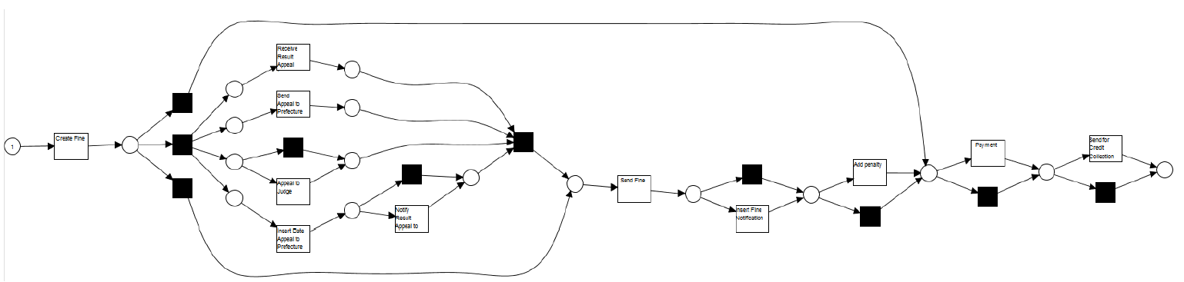
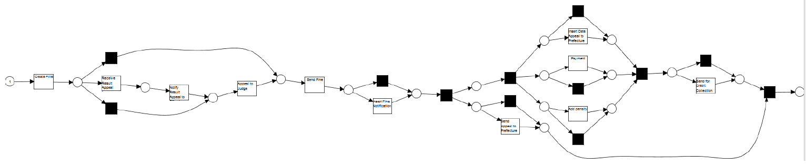
Evaluation: Real-life Event Log
Original log model
Filtered log model

Slide 25
Evaluation: Real-life Event Log
9 Constraints:
Responded-Existence : “Notify Result Appeal to Offender” , “Insert Date Appeal to Prefecture”
NotResponse : “Add penalty”, “Insert Date Appeal to Prefecture”
Edit distance : 3
Terminate after 500,000 unique trees
Pareto front : 54 process trees

Slide 26
Evaluation: Real-life Event Log

Slide 27
Next Steps
Smarter Modification Approach
Modify the process tree using the constraints
Domain knowledge
During Process Discovery
During Event logging
Domain knowledge beyond control flow (case/event level attributes)

Slide 28
Thank you!!
Questions?

