Slide 1
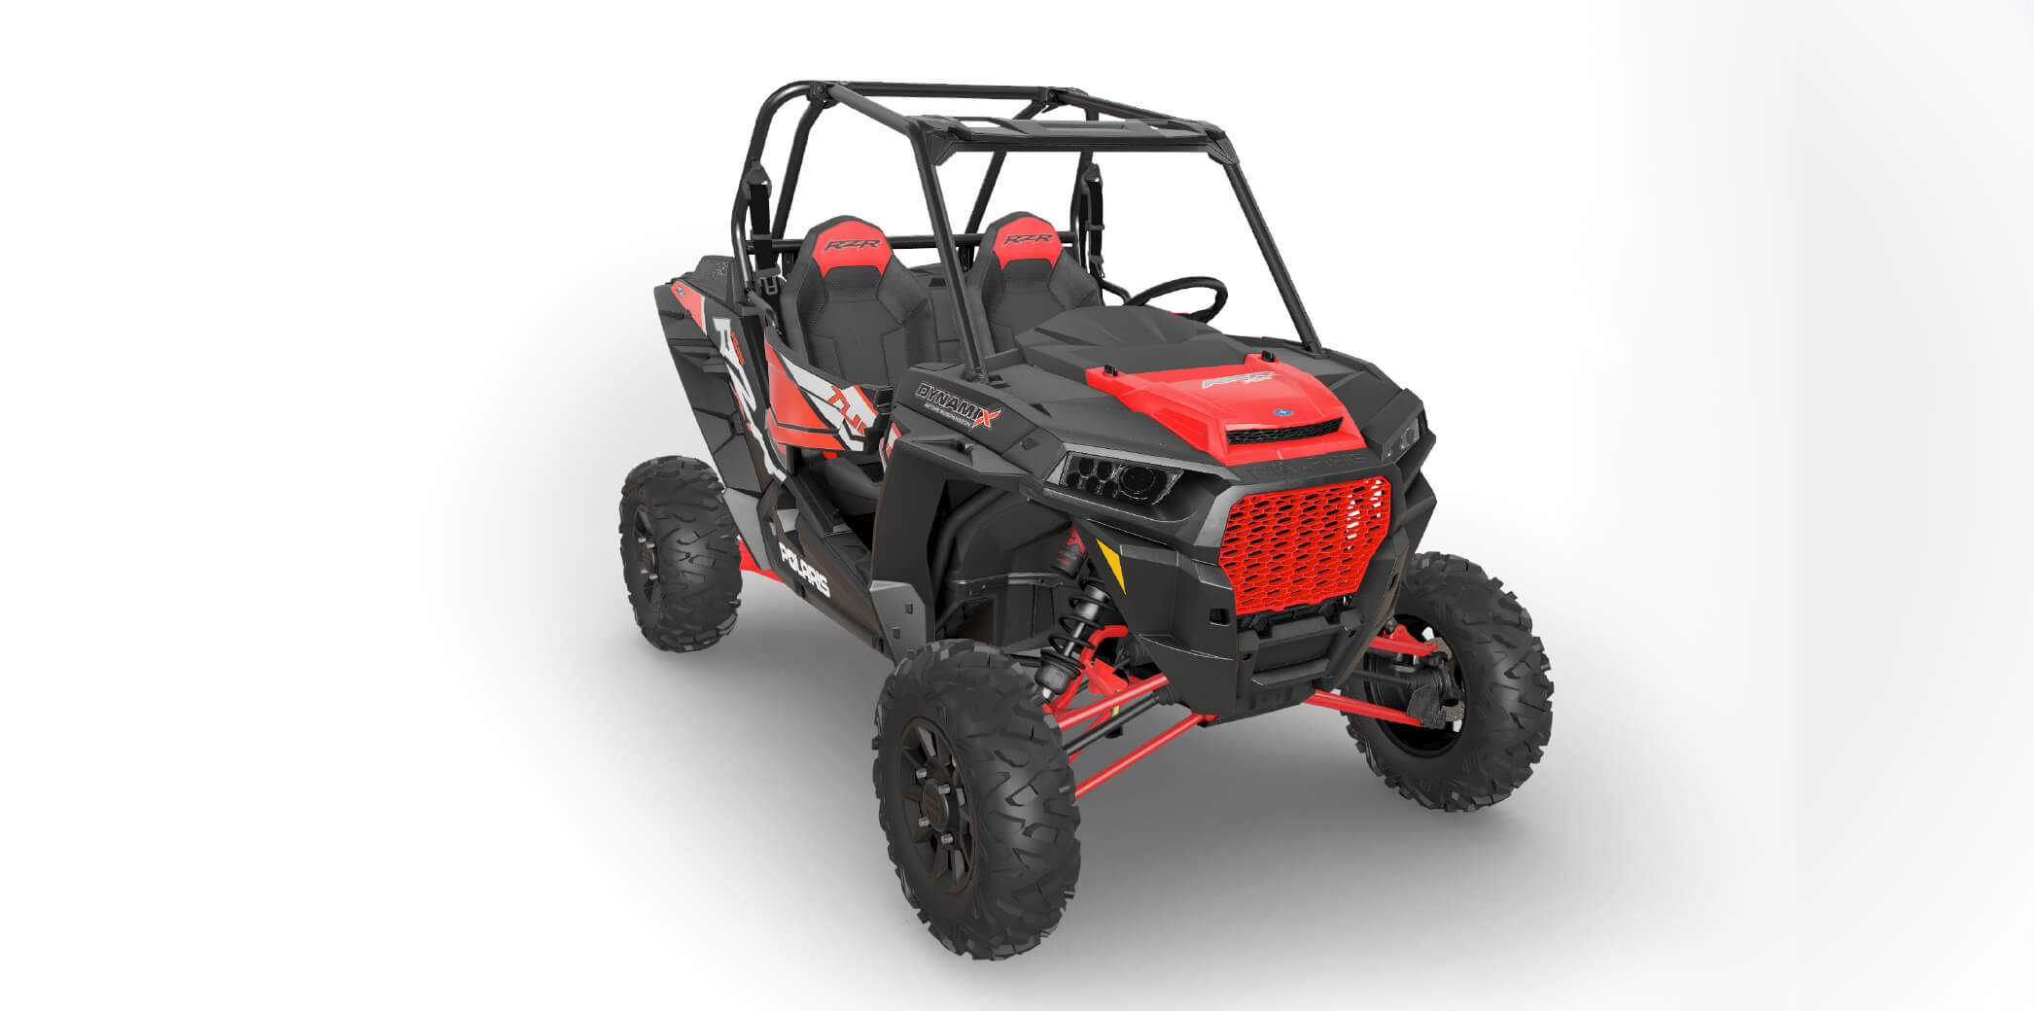
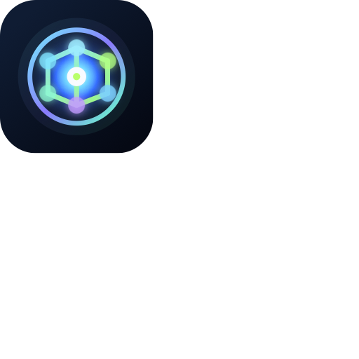
BROWSER-NATIVE 3D INFRASTRUCTURE
01
Loopnode builds a premium operating layer for realtime 3D on the web.
A browser-native platform for scene creation, runtime delivery, collaborative review, and high-fidelity launch surfaces across games, XR, commerce, and interactive product experiences.
Premium web-native 3D stack

Slide 2
01 PRODUCT THESIS
02
Most teams still piece together modern 3D delivery from disconnected tools.
1
One browser workspace instead of fragmented tooling
Scene editors, runtime code, review links, asset pipelines, deployment workflows, and analytics are usually managed as separate systems. Loopnode compresses that sprawl into one cleaner product surface.
2
Faster iteration from scene edits to published output
3
A better fit for product teams than engine-first workflows

Slide 3
02 MARKET SHIFT
03
Why the category matters now
Interactive 3D is moving beyond game studios into product, commerce, simulation, and immersive web experiences.
Browser expectations are rising
WebGPU expands the ceiling
Teams need productized infrastructure
Premium launches now need richer visual surfaces, motion, and spatial interaction directly on the web.
Modern browser graphics make higher-fidelity realtime rendering practical for a wider product set.
Creative, engineering, and go-to-market teams need a system that feels deployable, not improvised.

Slide 4
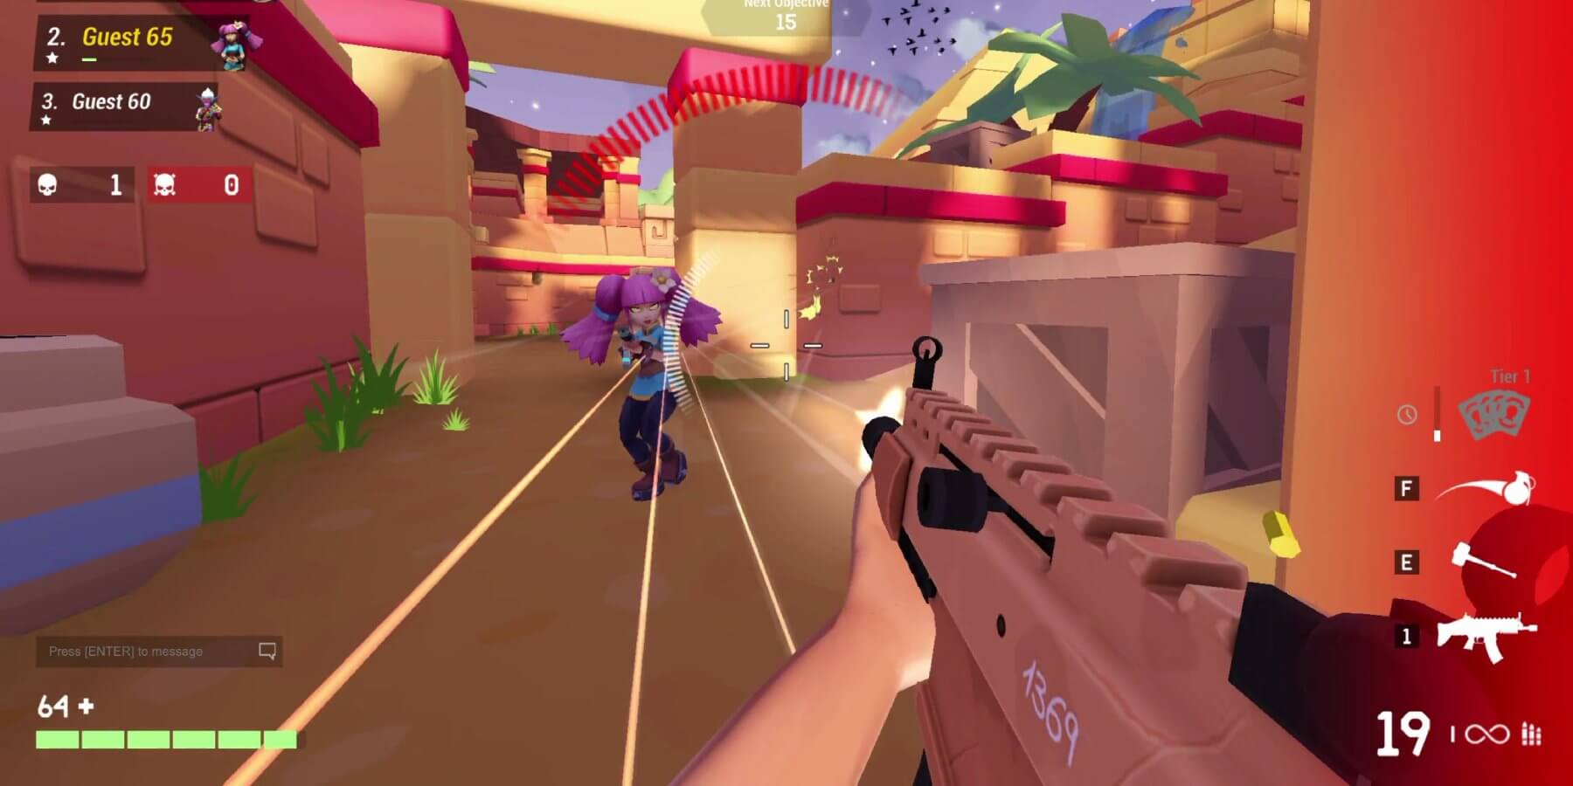
03 WORKFLOW
04
Loopnode keeps composition, review, and launch inside one operating flow.
The platform is built for teams that want design and technical control without losing speed. Scene building, logic, previewing, and deployment stay connected.
Browser scene editing with premium output paths
Realtime previews for faster stakeholder review
A more coherent handoff between creation and deployment

Slide 5
04 STACK
05
A six-layer product stack
01
Editor cloud
04
Team operations
Scene composition, hierarchy control, materials, and environment setup in the browser.
Approvals, comments, review checkpoints, and shared production governance.
02
Realtime engine
05
Launch fabric
WebGPU and WebGL delivery, rendering control, interaction logic, and optimized runtime performance.
Deployment to landing pages, product showcases, immersive demos, and XR endpoints.
03
Asset graph
06
Data connectors
Models, textures, media, scripts, and structured reuse across product teams.
Commerce, CMS, analytics, telemetry, and external system integration.

Slide 6
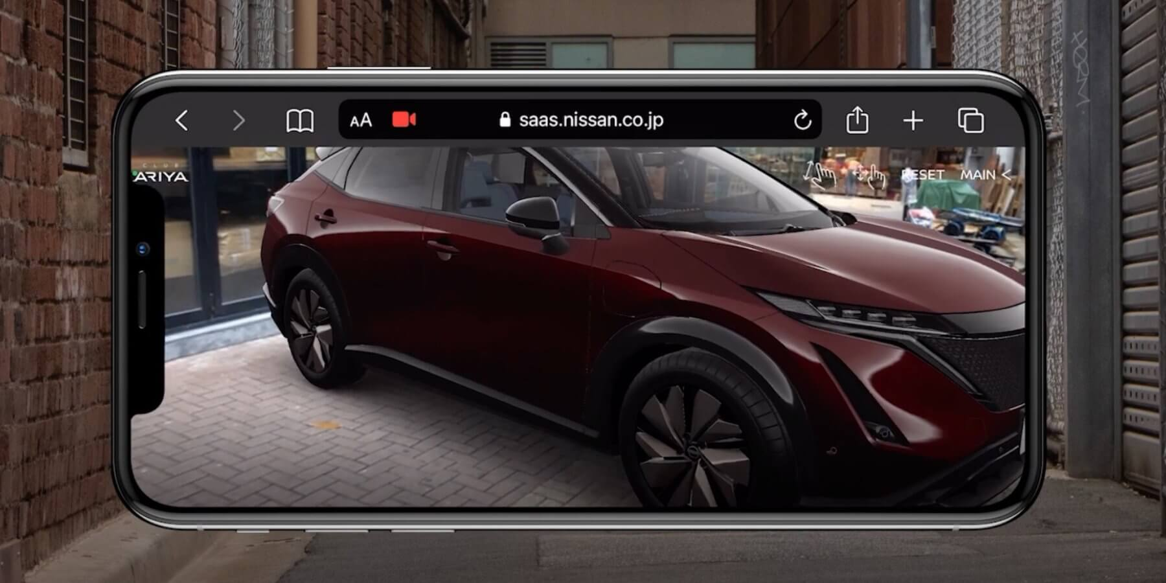
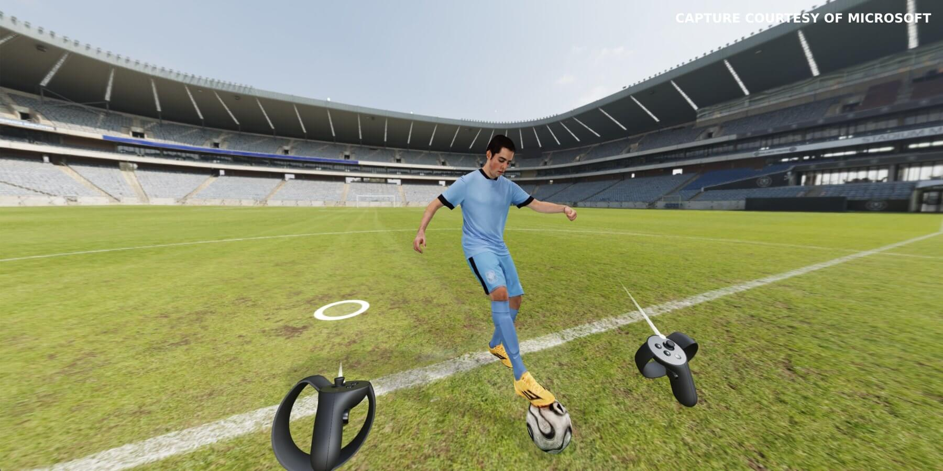
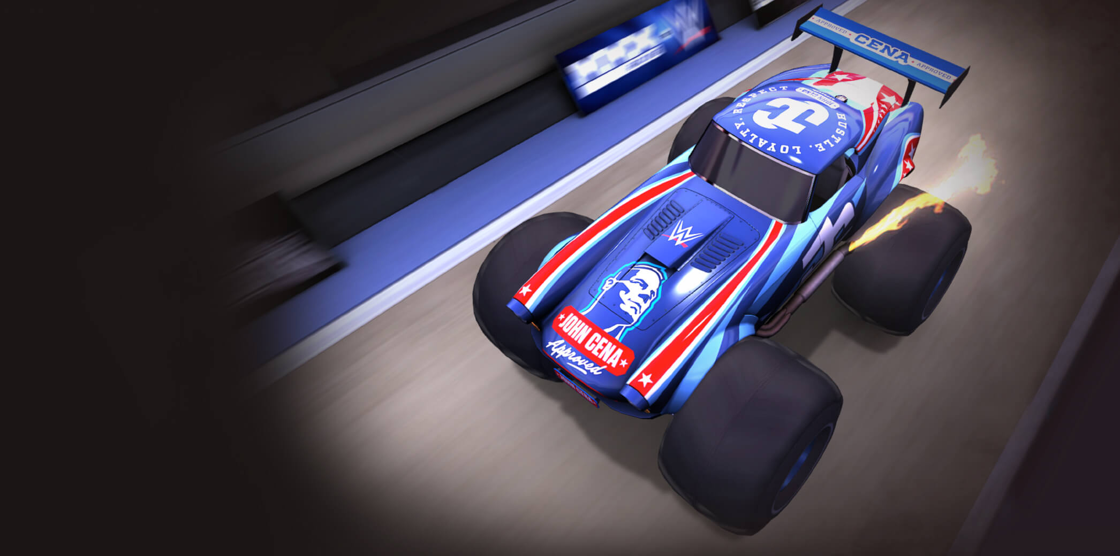
05 SURFACES
06
The platform is designed for multiple commercial surfaces, not one narrow use case.
Loopnode can support browser games, XR experiences, product configurators, interactive campaigns, and other premium spatial interfaces.
Surface range
Games AR VR Configurations Interactive ads

Slide 7
06 FEATURE PILLARS
07
The product combines creative speed with a more modern technical base.
WebGPU ready
Zero compile loops
AI-assisted creation
Collaboration
A modern graphics path while maintaining practical browser coverage.
Faster iteration with a JavaScript-native workflow.
Vibe coding, editor automation, and natural-language acceleration.
Realtime teamwork without turning review into a separate product.

Slide 8
07 BUYERS
08
Initial demand comes from teams building visually ambitious digital products.
The strongest wedge is not only gaming. Loopnode can be sold into studios, product teams, immersive commerce groups, simulation builders, and agencies shipping high-fidelity interactive work.
Game and interactive studios
Commerce and configuration teams
XR and simulation product groups
Agencies building launch-ready immersive surfaces

Slide 9
08 POSITIONING
09
Where Loopnode is different
A product-first comparison of how Loopnode is positioned against the usual assembled stack.
Loopnode
Typical stack
Scene workflow
Browser-native scene workflows
Usually external or fragmented
Review layer
Review inside product flow
Often handled with patchwork tools
Product framing
Launch-ready product framing
Often engine-centric rather than product-centric
Operational stack
Connected runtime + asset + team layer
Commonly assembled by hand

Slide 10
09 ROLLOUT
10
A practical expansion path
Phase 1
Phase 2
Phase 3
Phase 4
Launch editor, runtime, and browser publishing around a premium 3D creation wedge.
Deepen asset operations, collaboration, and review workflows for production teams.
Expand into AI-assisted creation, automation, and more structured deployment tooling.
Broaden into more complex spatial product systems, data integrations, and enterprise surfaces.

Slide 11
10 REVENUE MODEL
11
Revenue can compound across software, workflow depth, and delivery infrastructure.
Platform access
Production modules
Services + integrations
Core subscription or enterprise access to the editing and runtime environment.
Higher-value layers for collaboration, governance, publishing, and analytics.
Implementation, migration, deployment configuration, and data connections.

Slide 12
11 WHY THIS WINS
12
The opportunity is to make browser 3D feel less like raw tooling and more like a finished product system.
Loopnode
Loopnode is differentiated by product coherence. Instead of asking teams to assemble scene tooling, runtime logic, review workflows, and launch mechanics on their own, it offers a cleaner operating layer designed around the actual shipping process.

Slide 13
12 CLOSING
13
Loopnode
A premium browser-native 3D platform for teams building interactive products, immersive launches, and realtime spatial experiences.
hello@loopnode.net

