Slide 1
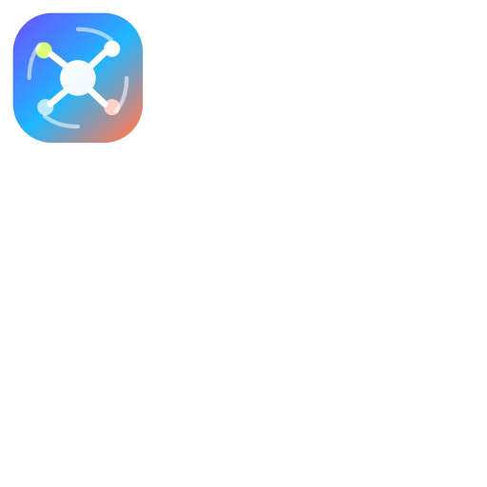
AIPIs
A unified platform for accessing, routing, and monetizing AI providers like ChatGPT, Claude, Qwen, Ollama, and future model endpoints from one product layer.
MULTI-MODEL AI API PLATFORM
Pitch Deck
April 2026

Slide 2
PROBLEM
The AI ecosystem is fragmented, fast-moving, and painful to integrate repeatedly.
Teams want access to the best model for each task, but every provider adds auth, schema differences, pricing logic, fallback behavior, and operational complexity.
Too many providers
Switching is expensive
No shared control
Lock-in risk
OpenAI, Anthropic, Qwen, Ollama, and others all require separate integration and maintenance paths.
Moving products between models often means rewriting prompt logic, schemas, and app controls.
Without a platform layer, usage, routing, billing, and failover stay fragmented.
One-provider dependency creates business risk the moment model quality, pricing, or availability changes.

Slide 3
PRODUCT
AIPIs gives users and developers one access layer across many AI providers.
The platform provides a chat experience, provider switchboard, unified API gateway, and control plane for usage, routing, and model orchestration.
Chat interface
Unified API
Routing engine
Usage controls
Users can interact with different models from one product experience.
Developers hit one endpoint layer instead of wiring every provider directly.
Requests can be sent to the best model by policy, latency, cost, or workload type.
Metering, quotas, and customer plans attach directly to AI usage.

Slide 4
ARCHITECTURE
An orchestration layer between apps and model providers.
Input
Gateway
Routing
Providers
Control plane
User app, chat client, or API consumer
Auth, normalization, quotas
Policy, fallback, model selection
Claude, ChatGPT, Qwen, Ollama
Logs, billing, analytics
AIPIs can support hosted LLMs, open-weight deployments, local inference, and future providers through one commercial and operational plane.

Slide 5
DIFFERENTIATION
The moat is control across providers, not dependence on one model vendor.
Unified switching
Commercial infrastructure
Resilience and speed
AIPIs makes provider changes operationally cheap for the customer.
Usage, quotas, plans, and product controls are built into the AI layer itself.
Fallback and routing reduce outages, latency problems, and provider volatility.
AIPIs helps teams ship multi-model products faster while retaining visibility and flexibility as the market changes.

Slide 6
MARKET
Customers range from individual power users to developer platforms.
Power users
Startups
Enterprise teams
Developers
Users who want access to multiple AI models without managing separate tools.
Product teams building features on top of more than one provider.
Operators who need governance, routing, cost control, and provider flexibility.
Teams who want one API instead of many provider contracts and integrations.

Slide 7
BUSINESS MODEL
A product business with platform and API upside.
Subscription access
B2B platform
Unified AI API
Users pay for premium model access, higher limits, and provider-specific features.
Companies license orchestration and control capabilities for internal and product use.
External developers pay for AIPIs endpoints rather than integrating every provider themselves.

Slide 8
ROADMAP
Start with provider access, expand into orchestration infrastructure.
Phase 1
Phase 2
Phase 3
Chat UI, initial providers, unified request layer, and account-level usage controls.
Routing logic, fallback rules, pricing tiers, and observability dashboards.
Enterprise policy controls, workflow APIs, and deeper private model support.
The long-term position is a default access layer for teams that want provider agility without operational fragmentation.

Slide 9
CLOSING
AIPIs is building the access layer for the multi-model AI era.
One interface, one gateway, and one control plane for the AI providers people actually want to use.
Contact
Founding platform deck for AIPIs
multi-provider ai access infrastructure

